Slide 1
Blue Rewards Incentive Completion

Slide 2
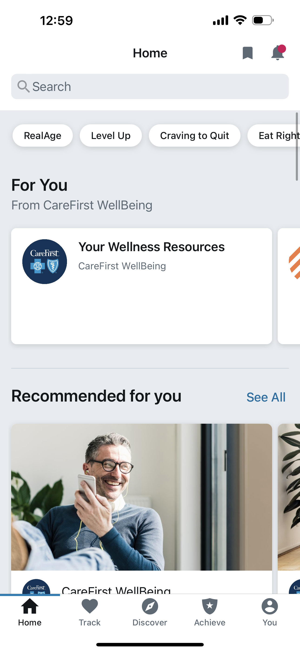
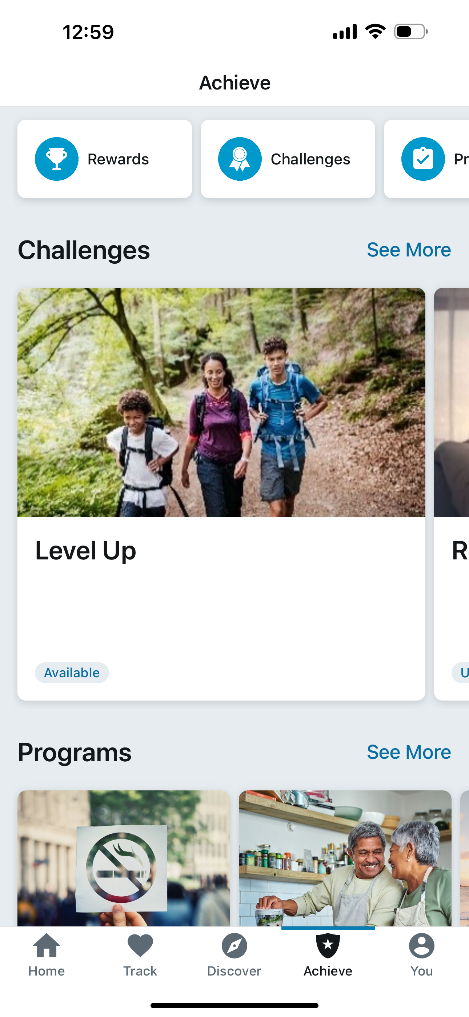
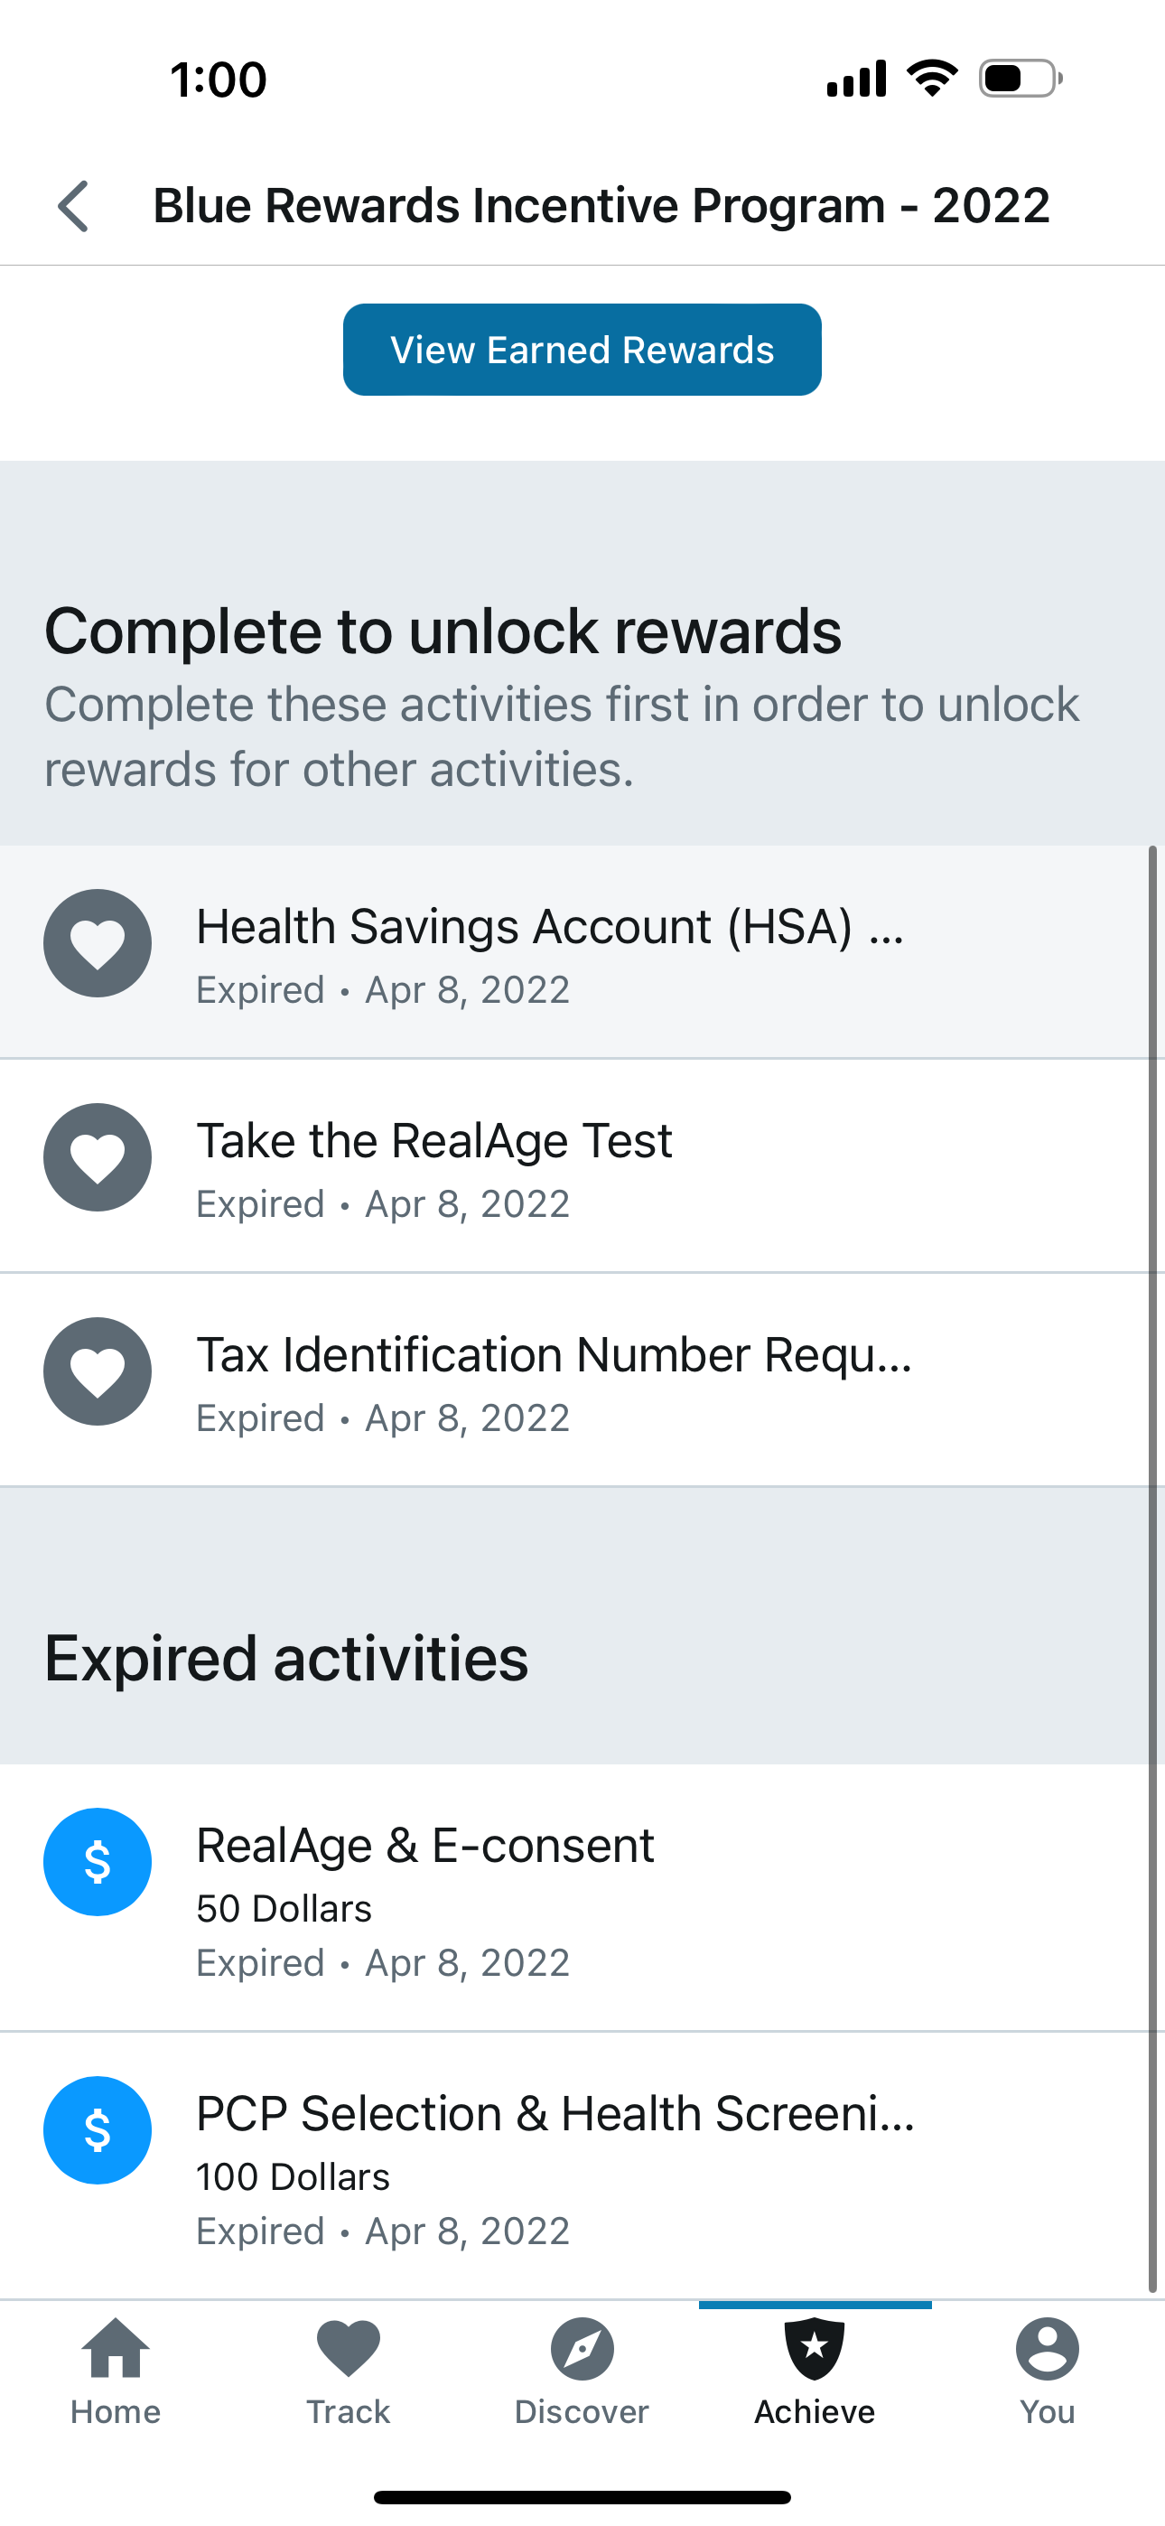
Navigating to the Rewards Page in CareFirst WellBeing
Select “Achieve” from the bottom navigation bar
Select the “Rewards” tile and you will enter the Rewards section of the platform to access your Health Screening options and other Blue Reward steps

Slide 3
Blue Rewards – Health Screening Options
Annual Health
Screening Incentive
(Premium Reduction)
PCP Health Screening Form
1. Make appointment with PCP
2. Gather lab data
3. Visit PCP to complete health screening form
4. Enter results online
CVS MinuteClinic
1. View/Print form for CVS
2. Diagnostic collection at CVS
3. Review results online

Slide 4
PCP Health Screening Option
Notes:
Master slide: Section Divider
The dark blue design for title and section divider and conclusion slides is our standard layout. If necessary for printing purposes, you may use the lighter versions. Or consider printing the “Handout” layout, which has multiple slides on each printed page.
DO NOT ADD PHOTOS OR GRAPHICS TO THIS SLIDE
If you want a photo on your divider slide, use slide master ”Section Divider Large Photo”.

Slide 5
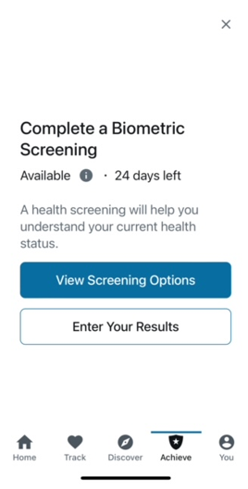
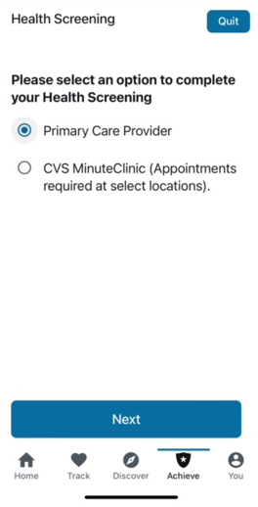
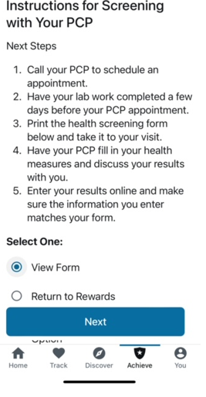
PCP Health Screening Option

Slide 6
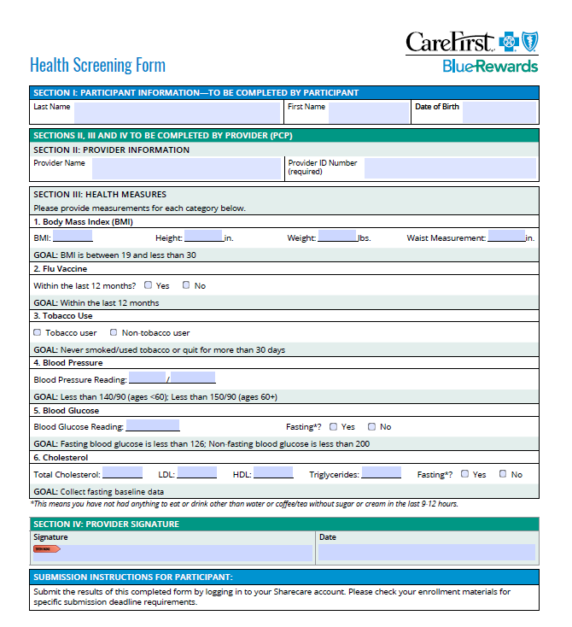
PCP Health Screening Form

Slide 7
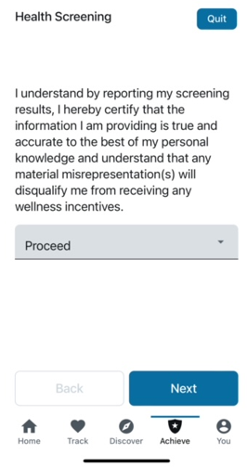
Entering Your Health Screening Results
Entering Results From your PCP Screening

Slide 8
CVS Minute Clinic Option
Notes:
Master slide: Section Divider
The dark blue design for title and section divider and conclusion slides is our standard layout. If necessary for printing purposes, you may use the lighter versions. Or consider printing the “Handout” layout, which has multiple slides on each printed page.
DO NOT ADD PHOTOS OR GRAPHICS TO THIS SLIDE
If you want a photo on your divider slide, use slide master ”Section Divider Large Photo”.

Slide 9
CVS MinuteClinic – Process Overview
If you would like to use the CVS MinuteClinic for their health screening, you will need to bring the appropriate screening form with you to the visit.
The form is intended to educate the CVS MinuteClinic provider and you about the Biometric Screening and which metrics will be collected during the visit.
The following will be collected during the health screening visit:
  Blood Sugar Glucose Testing (Fasting or non-fasting glucose )
  A1C Check (only collected for those who attest to being diabetic
  Body Mass Index (BMI)
  Blood Pressure
  Smoking/Tobacco Use Status
  Flu Vaccine Status
  Cholesterol

Slide 10
CVS MinuteClinic – In-Area & Out-of-Area Flow
The CVS MinuteClinic option will be available to all CareFirst members but the experience differs based on whether the visit is in or out of the CareFirst Service area.
In-Area (MD, DC, VA)
You will need to register/log-in to your CareFirst Wellbeing Platform to access the CVS MinuteClinic form.
You will select the CVS Minute Clinic Location that is closest to you and make an appointment. Be sure to bring your health insurance card. There should be no cost share to you!
Once you have completed the screening, CVS will send CareFirst the results from the screening to be uploaded into your CareFirst WellBeing platform so you can earn the premium discount (meaning no need to do anything else!)
Out-of-Area (All Other Locations)
You will need to register/log-in to your CareFirst WellBeing Platform to access the CVS MinuteClinic form.
You will select the CVS Minute Clinic Location that is closest to you and make an appointment. Be sure to bring your health insurance card. There should be no cost share to you!
The form you brought with you to the screening will have a section on the page for the member/provider to record their health metrics.
After the visit, log into My Account or the CareFirst WellBeing Platform to enter your results (see screen shots on the next pages!).

Slide 11
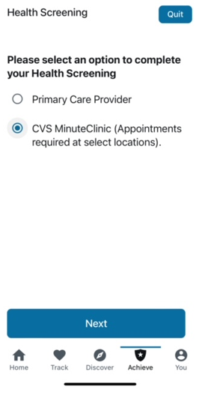
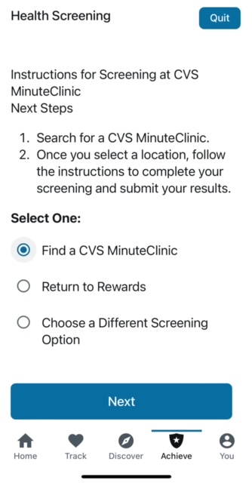
CVS MinuteClinic

Slide 12
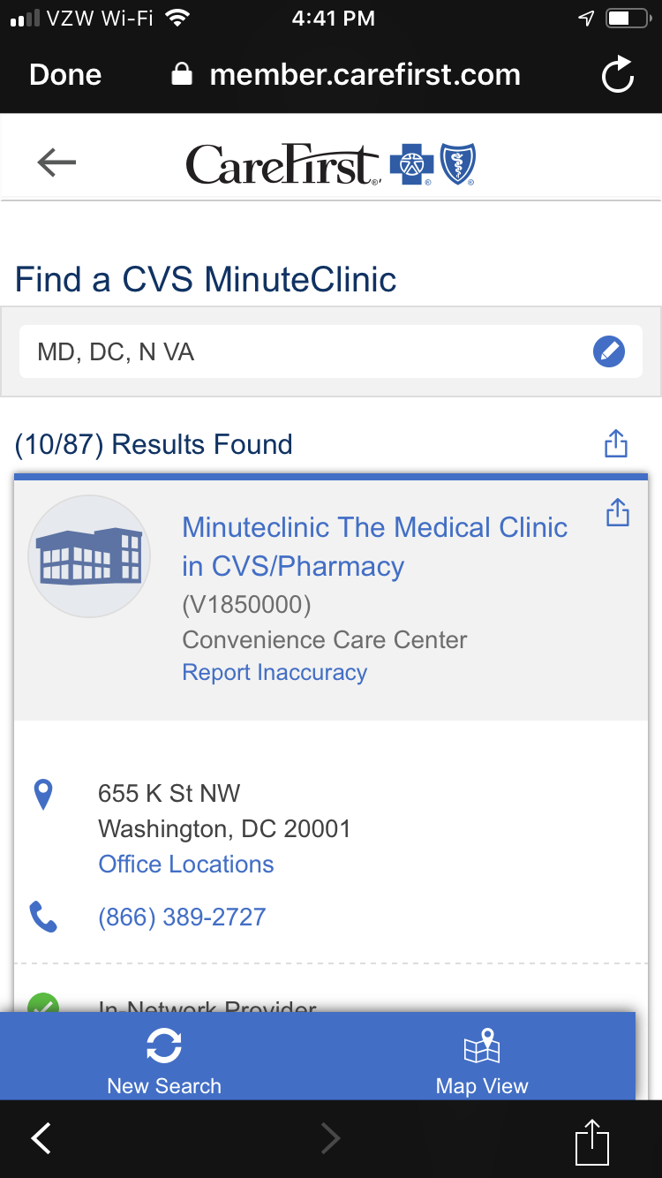
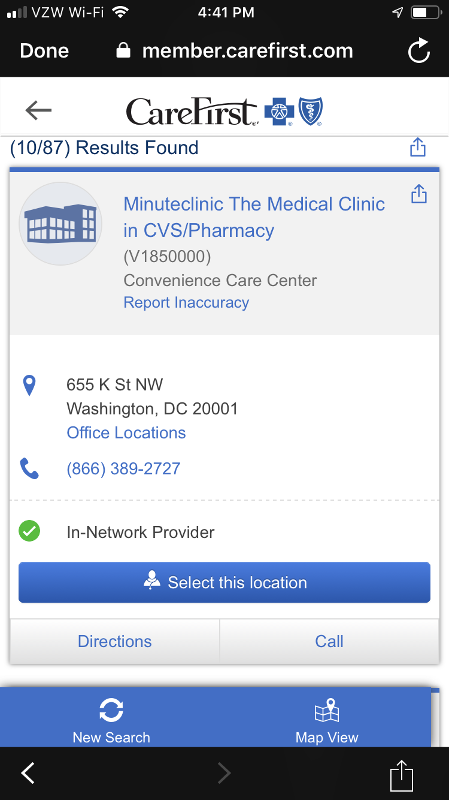
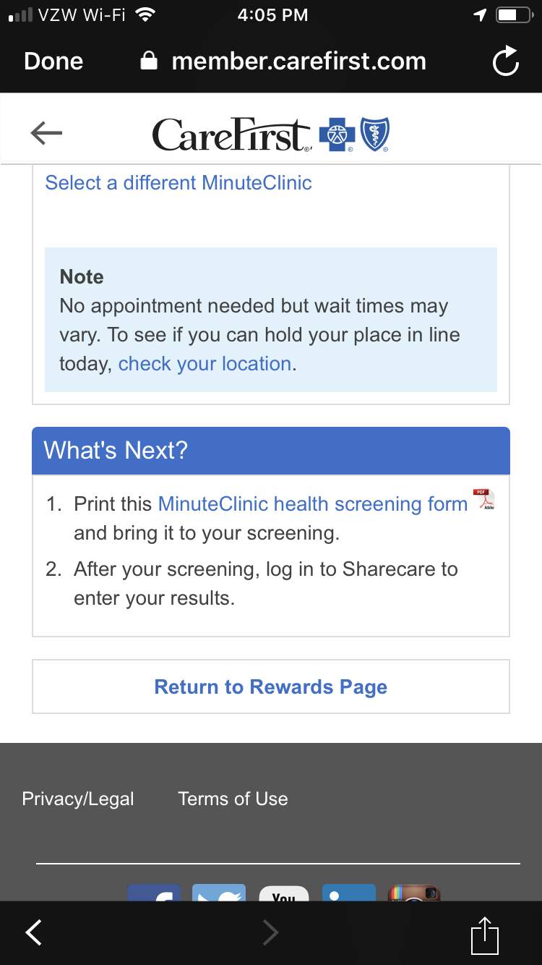
CVS MinuteClinic Appointment Set Up
After your screening, log into CareFirst WellBeing to log your results.

Slide 13
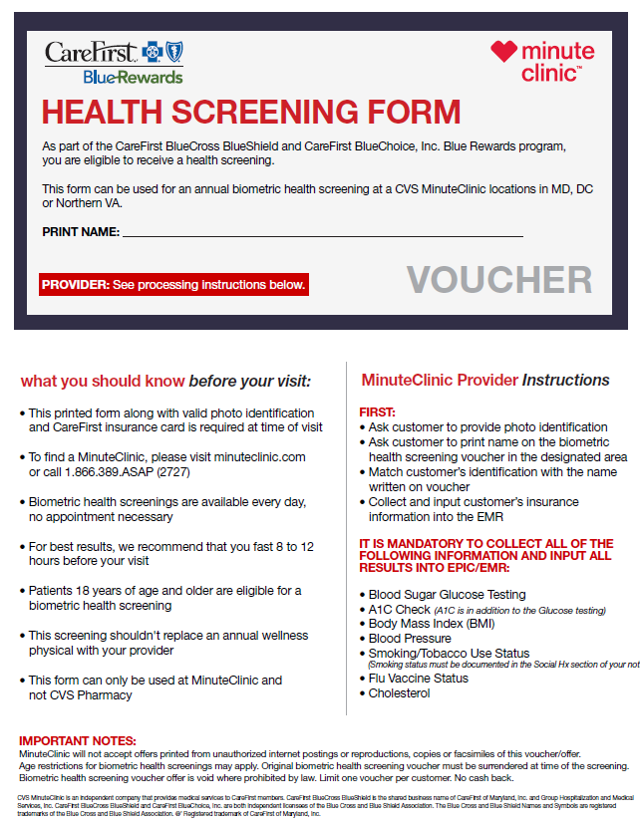
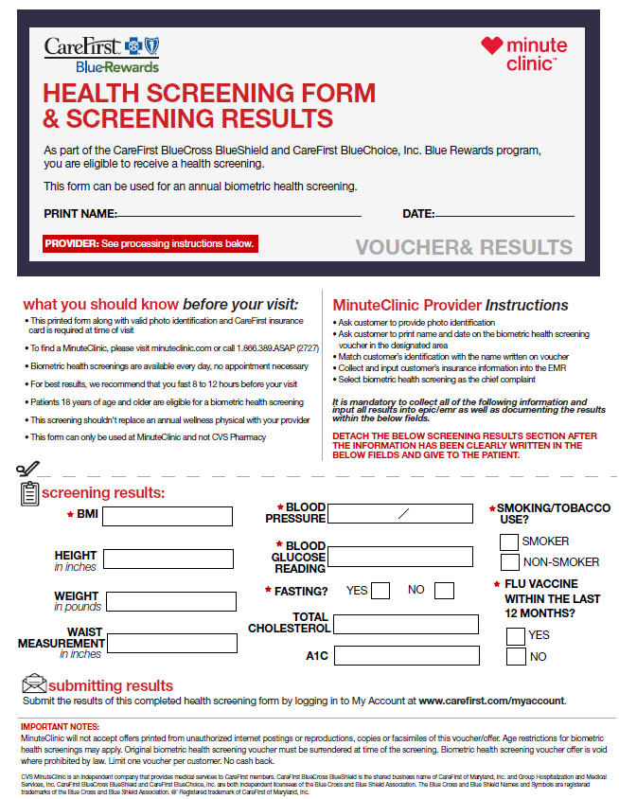
CVS MinuteClinic – In and Out-of-Area Form
In Area – MD, DC, VA
(your results are automatically uploaded into your CareFirst WellBeing Blue Rewards profile)
Out of Area
(you will need to enter results from your visit into your CareFirst WellBeing – Blue Rewards profile)

Slide 14
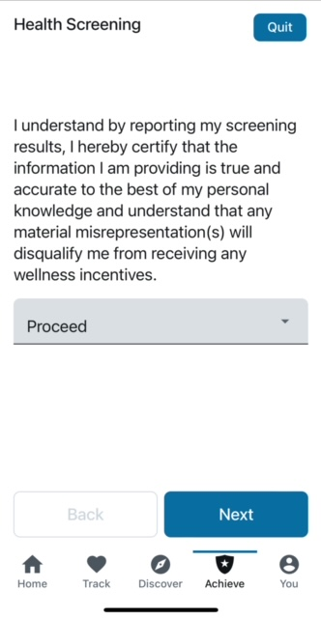
Entering Your Health Screening Results
Entering Results From an Out-Of-Area CVS Minute Clinic Screening is shown on the right.
In-Area CVS minute Clinics will automatically load results from the screening into your CareFirst WellBeing Portal.

