Slide 1




DC Government Open Enrollment 2026
Employees Hired After October 1, 1987

Slide 2
Medical Plan Options
Prescription Benefits
Making the Most of Your Plan
Behavioral Health
CareFirst WellBeing℠

Slide 3


What Is Open Enrollment?
November 10– December 08, 2025
Your opportunity each year to review and make changes to your benefits
Enroll in a health insurance plan
Add or remove dependents
Make changes to plan enrollment, coverage,
health spending/savings account contributions

Slide 4
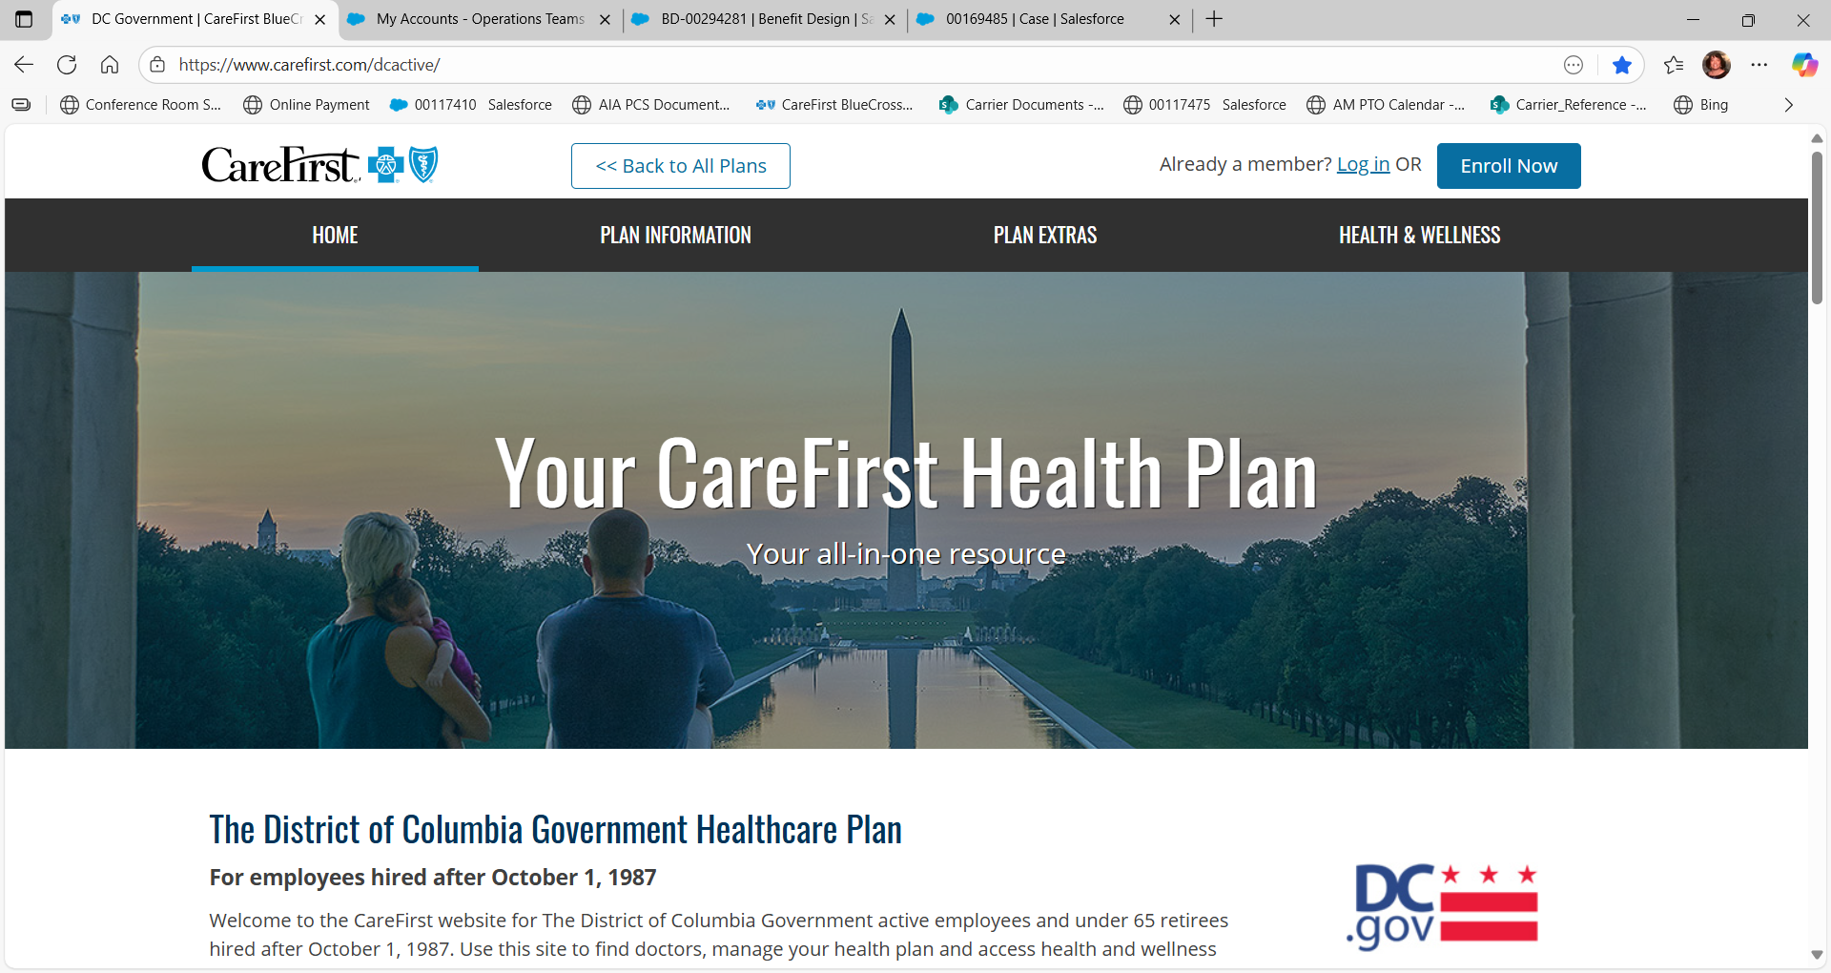
DC Gov’t CareFirst website

Slide 5
Medical Plan Options
5

Slide 6
REGIONAL PLAN - HMO
MEDICAL PLANS
Plan highlights
Selection of PCP | Required (BlueChoice Network PCP)
Referrals | Not required
Network labs | Use of LabCorp required
In-network | BlueChoice Network—only available in MD, D.C. and Northern VA (no balance billing)
Out-of-network | No coverage
Out-of-area coverage | Emergency or urgent care only

Slide 7
REGIONAL PLAN - HMO
 | In-network
Annual medical deductible (individual/family) | None
Annual medical & drug out-of-pocket maximum (individual/family) | $3,500 single $9,400 Family
Preventive care | No charge
Primary care provider (PCP) office visit | $10 copay
Specialist office visit (new copay) | $25 copay
Labs (non-hospital)/(hospital) | No charge
X-ray (non-hospital)/(hospital) | No charge
Specialty imaging (non-hospital)/ (hospital) | No charge
Convenience care (retail health clinic) | $10 copay
Urgent care (new copay) | $25 per visit
Emergency room | $100 per visit (waived if admitted)
Inpatient hospital services—facility | $100 per admission
CareFirst BlueCross BlueShield
Proprietary and Confidential

Slide 8
NATIONAL PLAN- PPO
MEDICAL PLANS
Plan highlights
Selection of PCP | Recommended
Referrals | Not required
Labs | No restrictions
In-network | CareFirst PPO Network (no balance billing)
Out-of-network | Non-participating providers (will be balance billed)
Out-of-area coverage | BlueCard PPO Network (no balance billing) Non-participating providers (will be balance billed)

Slide 9
NATIONAL PLAN- PPO
 | In-network | Out-of-network
Annual medical deductible (individual/family) | $750/$1,500 | $1,500/$3,000
Annual medical & drug out-of-pocket maximum (individual/family) | $1,750/$3,500 | $3,000/$6,000
Preventive care | No charge | After deductible is met, 25% of CareFirst member cost
Primary care provider (PCP) office visit | $15 per visit | After deductible is met, 25% of CareFirst member cost
Specialist office visit | $15 per visit | After deductible is met, 25% of CareFirst member cost
Labs (non-hospital)/(hospital) | After deductible is met, 15% of CareFirst member cost | After deductible is met, 25% of CareFirst member cost
X-ray (non-hospital)/(hospital) | After deductible is met, 15% of CareFirst member cost | After deductible is met, 25% of CareFirst member cost
Specialty imaging (non-hospital)/ (hospital) | After deductible is met, 15% of CareFirst member cost | After deductible is met, 25% of CareFirst member cost
Convenience care (retail health clinic) | $15 per visit | After deductible is met, 25% of CareFirst member cost
Urgent care | $25 per visit | After deductible is met, 25% of CareFirst member cost
Emergency room | $100 per visit (waived if admitted) | $100 per visit (waived if admitted)
Inpatient hospital services—facility | After deductible is met, 15% of CareFirst member cost | 25% of CareFirst member cost

Slide 10
CDHP PLAN
This product provides national coverage
 | In-network benefits¹ Lowest out-of-pocket costs | Out-of-network benefits Highest out-of-pocket costs
Network Search: “Find a Doctor” | BlueChoice Advantage | Your plan offers coverage for out-of-network providers² Balance billing may apply for non-participating providers
PCP Selection | Recommended, but not required | Recommended, but not required
Referrals | Not required | Not required
¹ Maximize your in-network benefits by searching for providers or facilities that are the lowest cost to you. Use the Out-of-Pocket Costs filter and select In Network: Lowest Out-Of-Pocket.
² Your plan offers coverage for out-of-network providers, but you will pay more out of pocket than you would if you selected an in-network provider or facility. .

Slide 11
CDHP PLAN
 | In-network | Out-of-network
Annual Medical/RX deductible (individual/family) | $1,800 Individual/$3,600 Family | $3,600 Individual/$7,200Family
Annual Medical/Rx out-of-pocket maximum (individual/family) | $3,250 Individual/$6,500 Family (note a decrease) | $5,950 Individual/$11,900 Family
Preventive care | No Charge | After deductible, 30% of Allowed Benefit
Primary Care Provider (PCP) office visit | After deductible, 0% | After deductible, 30% of Allowed Benefit
Specialist office visit | After deductible, 0% | After deductible, 30% of Allowed Benefit
Labs | After deductible, 0% | After deductible, 30% of Allowed Benefit
X-ray | After deductible, 0% | After deductible, 30% of Allowed Benefit
Specialty imaging | After deductible, 0% | After deductible, 30% of Allowed Benefit
Urgent care | After deductible, 15% of Allowed Benefit | After deductible, 30% of Allowed Benefit
Emergency room | After deductible, 15% of Allowed Benefit | After deductible, 15% of Allowed Benefit
Inpatient hospital services—facility | After deductible, 15% of Allowed Benefit | Deductible, then 30% of allowed benefit

Slide 12
Prescription Benefits
12

Slide 13


Using Your Prescription Benefits
Review your plan and call CareFirst Pharmacy Services at
800-241-3371 with any questions.
Save money with generics, when available.
Fill prescriptions at one of 66,000 participating pharmacies nationwide or have them delivered right to your home using our Mail Order Pharmacy.

Slide 14
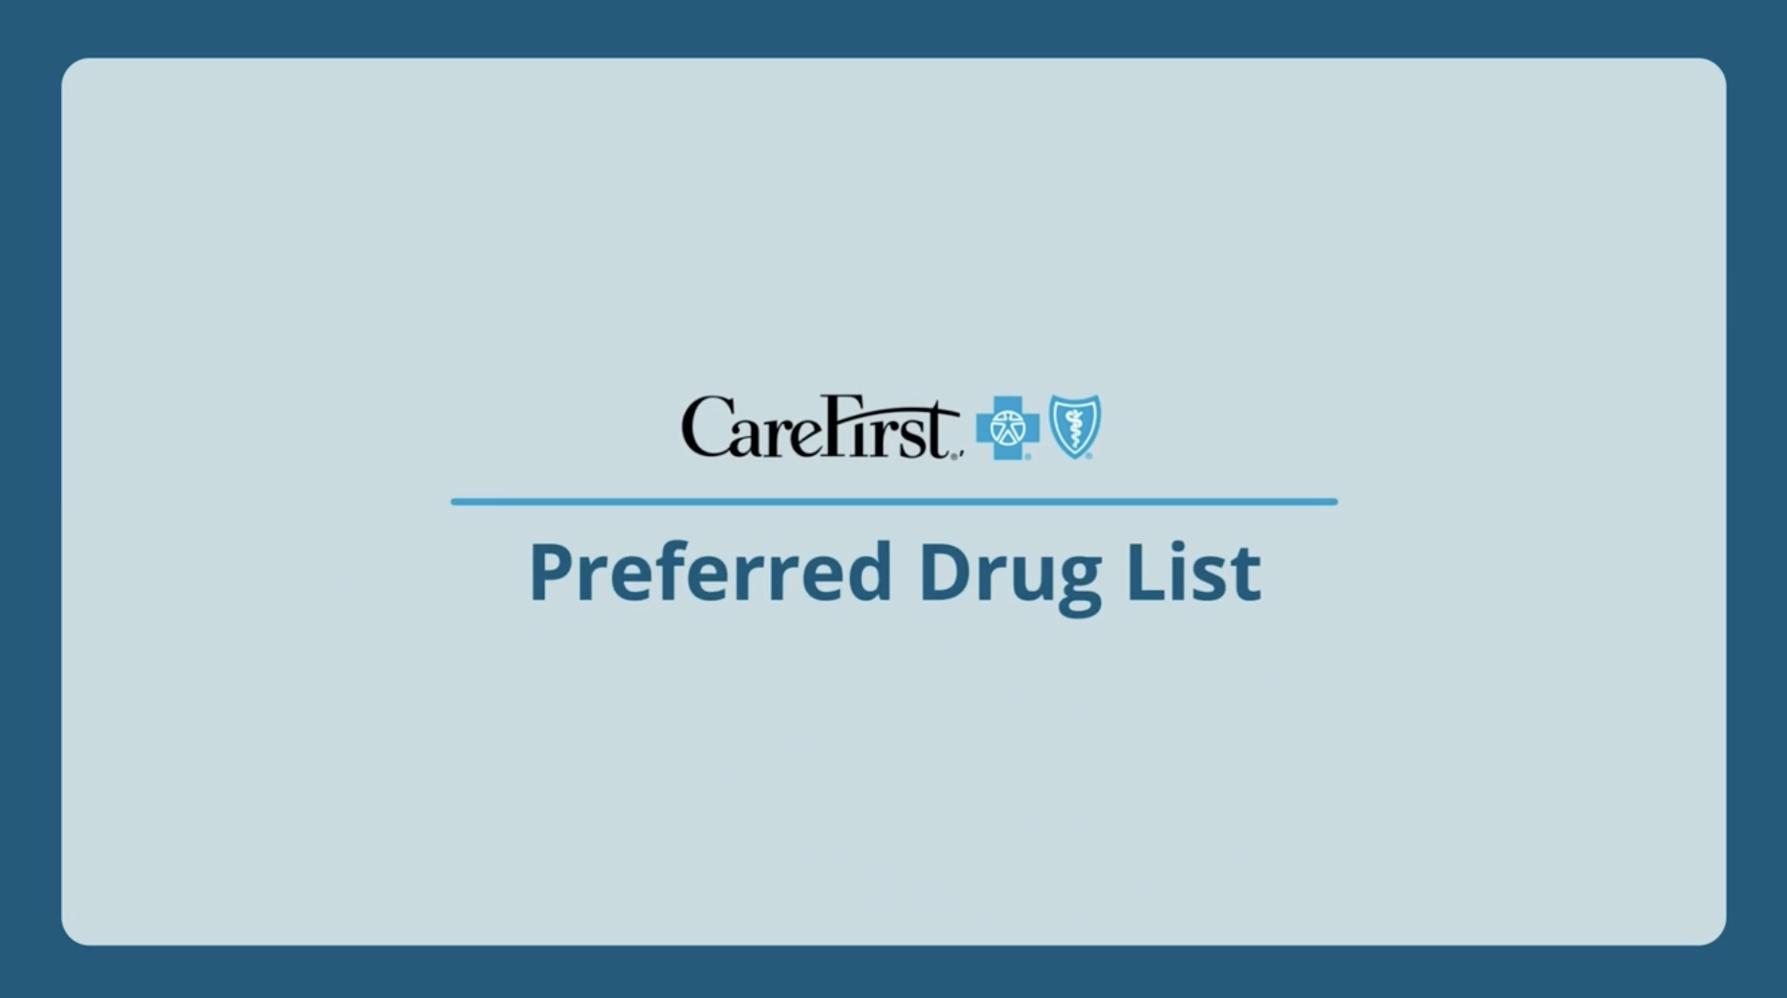
Understanding Your Formulary
Your formulary: Formulary 3
Available at carefirst.com/rx
List of prescription drugs your insurance plan covers
Organized by drug tiers so you can understand how much you pay for each drug
Your Preferred Drug List is a subset of your formulary that summarizes the generic and preferred brand medications covered by your plan that cost the least out-of-pocket
Your formulary is reviewed and updated on a quarterly basis to encourage utilization of safe and clinically cost-effective drugs
You will be notified by letter 30 days in advance if medications you’re currently prescribed will no longer be covered so you and your doctor can work together to find an alternative

Slide 15
5-TIER PHARMACY BENEFIT-
PRESCRIPTION BENEFITS
 | BlueChoice HMO Open Access Rx | BluePreferred PPO RX | BlueChoice Advantage CDHP HSA
Out of pocket Max* All copays are new with the exception of non-preferred RX copay | $3,500 Individual $9,400 Family | $1,750 Individual $3,500 Family | $3250 Individual $6500 Family
Tier 1: Generic drugs | $15 | $15 | $15
Tier 2: Preferred brand drugs | $30 | $30 | $30
Tier 3: Non-preferred brand drugs | $55 | $55 | $55
Tier 4: Preferred specialty drugs | $65 | $65 | $65
Tier 5: Non-preferred specialty drugs | $75 | $75 | $75
* No cost drugs are preventive drugs/oral chemotherapy drugs/diabetic supplies.
Notes:
Maintenance Medications co-pays the same as retail

Slide 16
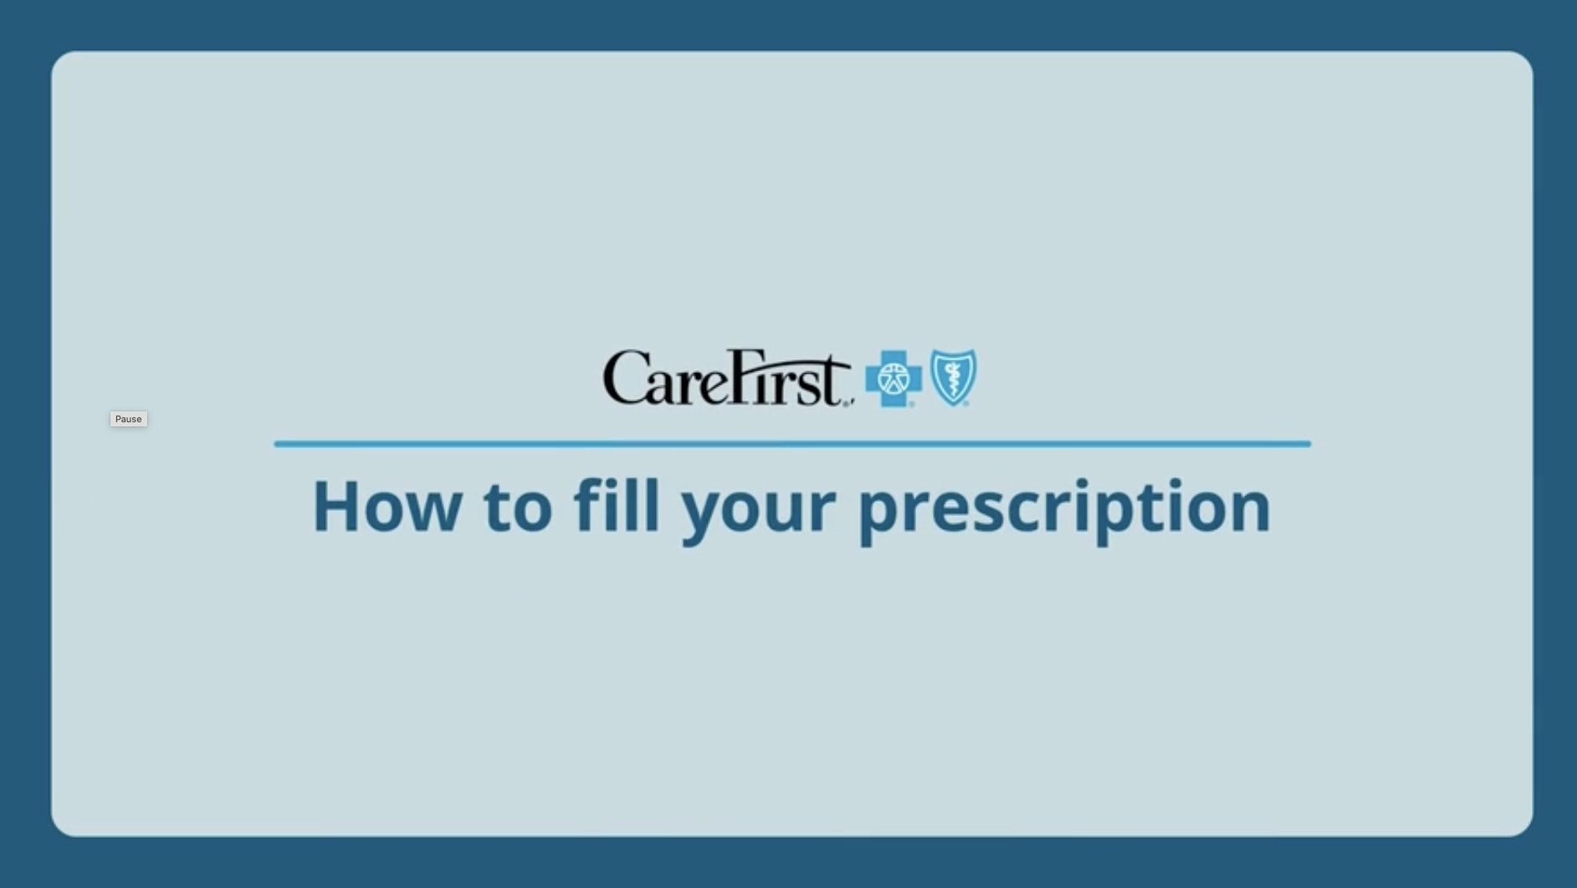

Mail Order Pharmacy (New two copays for a 90-day supply)
Save time and money on maintenance prescriptions
Fill prescriptions online, by phone or by mail
Schedule automatic refills
Select delivery location
Consult a pharmacist by phone 24/7
Receive email notification of order status
Visit carefirst.com/myaccount and log in.
Under the Coverage tab, select Drug and Pharmacy Resources.
Select Request a New Mail Order Prescription and enter the prescription information to be verified by your doctor.

Slide 17
Making The Most of Your Plan
17

Slide 18

Provider Search Tool
Search for doctors, hospitals, urgent care centers, other providers—nationwide
Search by name or specialty
Browse by category—such as primary care, behavioral health, dental, retail pharmacy
Review provider highlights, including specialties, locations, credentials, CareFirst health plans accepted
Quickly access CloseKnit—our virtual practice for primary care, urgent care and behavioral health
carefirst.com/dcactive

Slide 19
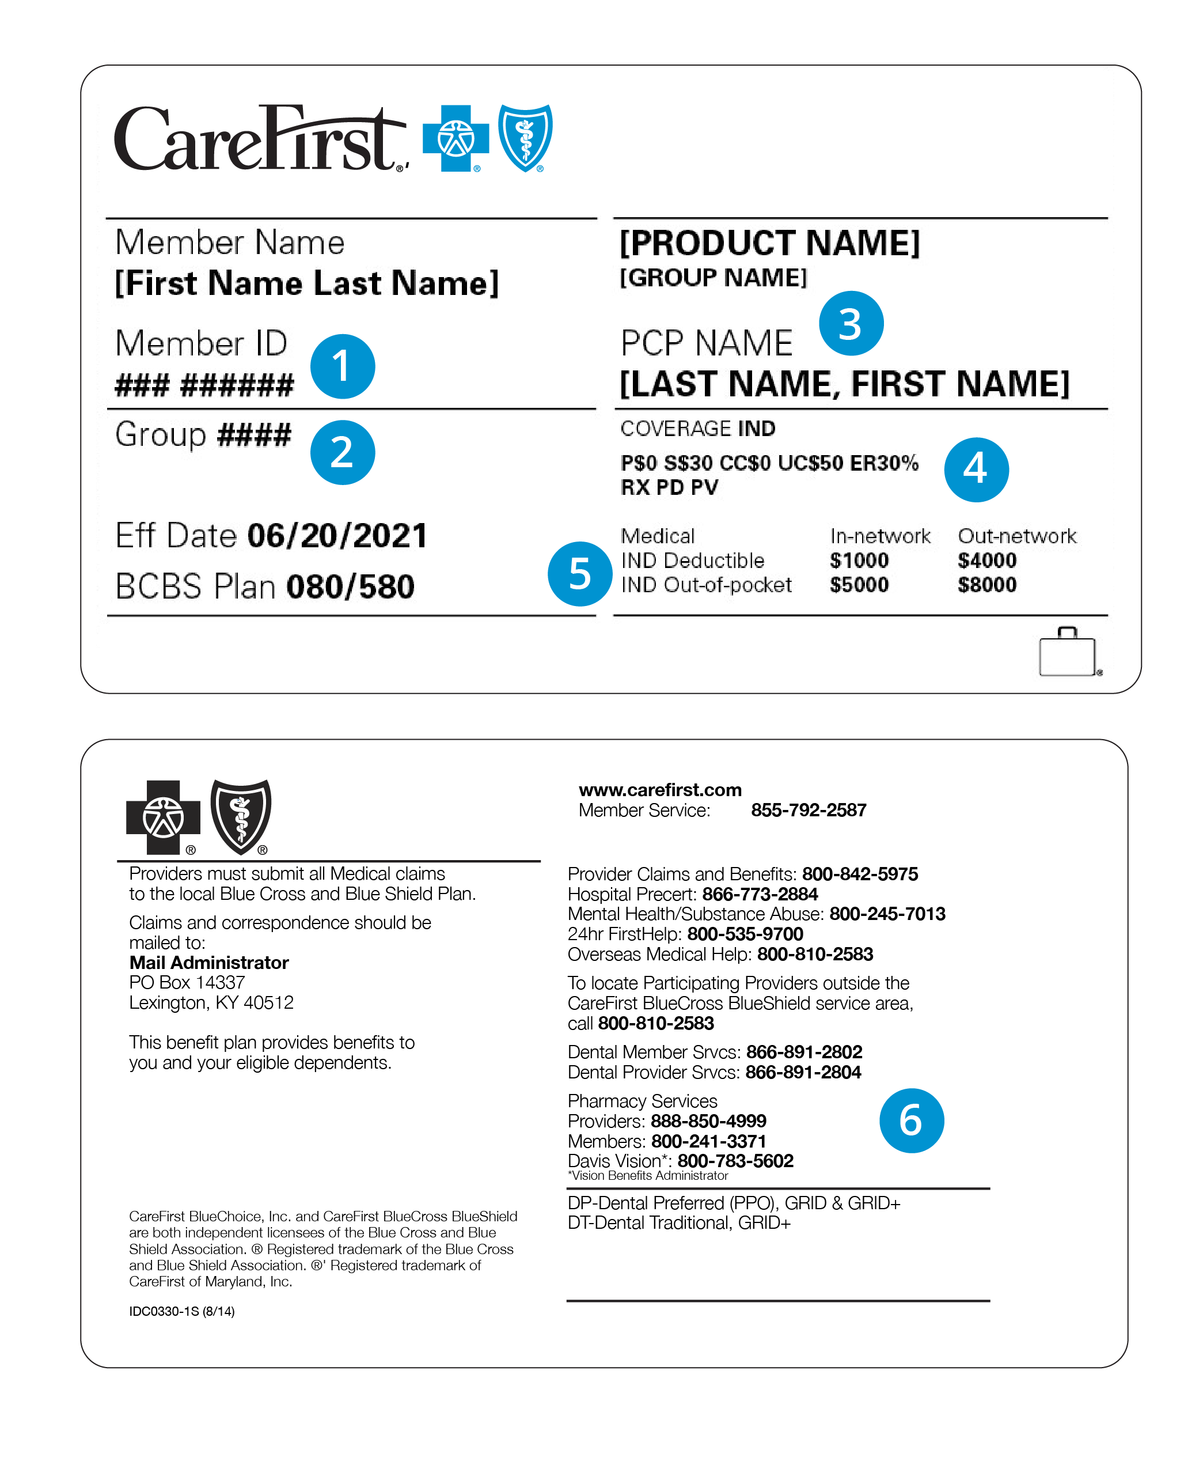
Your Member ID Card (everyone will be re-carded)
1
Member ID
2
Group number
3
Primary care provider (PCP)
4
Copays
5
Deductible and out-of-pocket max
6
Important phone numbers
CareFirst BlueCross BlueShield provides administrative claims payment services only and does not assume any financial risk or obligation with respect to claims.
19

Slide 20

My Account
Your personalized member portal
Search for doctors, hospitals, urgent care centers, other providers nationwide
View, order or email member ID cards
Check claims and deductible status
Update communication preferences and password
Quickly access a variety of CareFirst member programs
Download the CareFirst app or add carefirst.com/myaccount to your mobile favorites!

Slide 21






Virtual Care
CloseKnit, CareFirst’s leading virtual-care practice, gives you 24/7 access to primary care, urgent care, therapy and more through your computer or the CloseKnit mobile app
Advanced primary care
Dedicated Care Team to provide preventive care and support for chronic conditions. For adults ages 18+.
New parent support
Lactation services and support for parents, including prenatal risk assessments, post-natal feeding education and weaning programs.
Urgent care
Same-day care to treat minor injuries and common illnesses fast. Average wait time is 30 minutes or less. For adults and children ages 2+.
Nutrition services
Counseling and nutrition plans to support health needs, lifestyle goals, chronic illnesses and weight loss. For adults and children ages 5+.
Mental health services
Expert help from licensed therapists and psychiatrists, including short- and long-term therapy, as well as medication management and support. For adults and children ages 2+.
Scan the QR code or visit closeknithealth.com to get started.
21

Slide 22
CareFirst Wellbeing
22

Slide 23



Introducing CareFirst WellBeing*
Begin exploring your personalized digital connection to a healthier life by visiting carefirst.com/wellbeing.
* This well-being program is administered by Sharecare, Inc., an independent company that provides health improvement management services to CareFirst members. Sharecare, Inc. does not provide CareFirst BlueCross BlueShield products or services and is solely responsible for the health improvement management services it provides.

Slide 24






Connections to WellBeing
Motivating digital resources anytime, anywhere
RealAge®
Learn the physical age of your body, compared to your calendar age with the online health assessment.
Challenges
Get extra motivation for achieving your health goals.
Personalized health timeline
Receive recommendations and health information tailored to your goals and interests.
Health profile
Access your important health data all in one place.
Trackers
Connect your wearable devices or enter your own data to monitor sleep, steps, nutrition
and more.
Meditation, relaxation and more
Break free from stress with mindfulness tools, unwind at the end of the day or ease into a restful night of sleep with meditation, streaming music and videos.

Slide 25
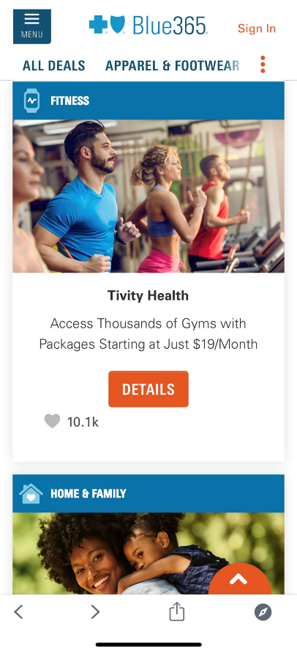
Blue365 Discount Program
Exclusive health and wellness discounts from top national and local retailers:
Apparel and footwear
Fitness (equipment, memberships)
Hearing and vision (hearing aids, Lasik, eye wear)
Home and family (baby, pets, home office, finance)
Nutrition
Personal care (oral care, grooming, skin care)
Travel (vacation, hotel, rental cars)
Access Blue365 through the CareFirst WellBeing app or by visiting carefirst.com/wellnessdiscounts.

Slide 26
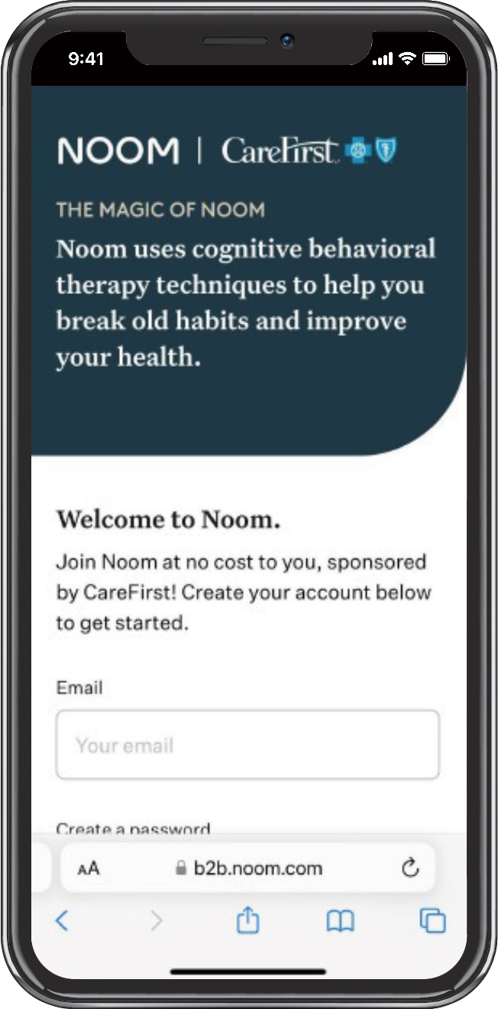
Noom
A digital, evidence-based weight and diabetes prevention program that helps you achieve sustainable, healthy habits over time
Psychology-based approach to help you better understand your relationship with food
Techniques that teach you the “why” behind your habits and how to change them
Interactive, digestible content, just 5–10 minutes daily
Option of a personal coach to support you as you move at your own pace
Added features like Noom Move, an extensive collection of workouts, as well as
GLP-1 Companion—a personalized experience for members on a GLP-1 weight loss medication
Get started with Noom today by creating or logging in
to your CareFirst WellBeing account.
Noom is brought to you on behalf of your CareFirst WellBeing program. Noom is an independent company that provides health improvement management services to CareFirst members. Noom does not provide CareFirst BlueCross BlueShield products or services and is solely responsible for the health improvement management services it provides.

Slide 27




BLUE REWARDS INCENTIVE PROGRAM
WELLBEING
You can earn a reward for completing one, or all of the following activities:
Consent to receive wellness emails and take the RealAge® test
The RealAge test is a simple questionnaire that will help you determine the physical age of your body compared to your calendar age.
Must complete within 180 days of your effective date.
Select a primary care provider (PCP) and complete a health screening
You can visit your PCP or a CVS MinuteClinic® to complete your screening.
Must complete within 180 days of your effective date.
Retake the RealAge® test
If you earned the reward for taking the test initially, you can earn an additional reward for retaking it after 90 days.
RealAge answers must be updated or confirmed no earlier than 90 days after the original assessment, and before the end of the benefit period.
Participate in health coaching
Session 1 = $30
Session 2 = $70
Session 3 = $100
Sessions must be held 2–60 days apart and must be completed before end of benefit period.
Earn $50
Earn $100
Earn $25
Earn up to $200
CVS MinuteClinic is an independent company that provides medical services to CareFirst members. CVS MinuteClinic does not provide CareFirst BlueCross BlueShield products or services and is solely responsible for the medical services it provides.

Slide 28
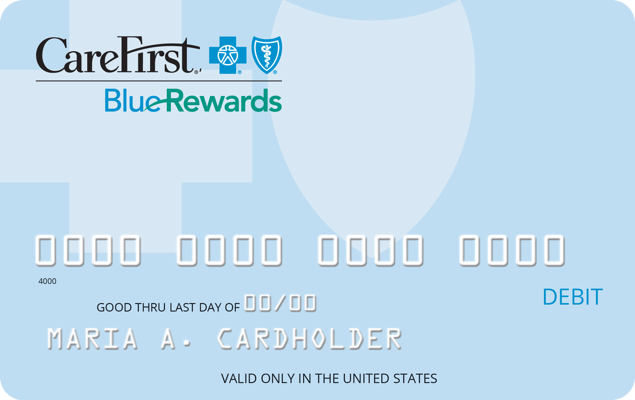
BLUE REWARDS INCENTIVE TYPE
WELLBEING
You’ll receive the CareFirst Blue Rewards Visa® Incentive Card in the mail once you complete any of the activities. The incentive card can be used to pay for your annual deductible or other out-of-pocket expenses like copays or coinsurance related to your CareFirst health plan.
You must use the funds before the end of the benefit period, as the balance does not carry over.
The CareFirst Blue Rewards Visa Incentive Card is issued by The Bancorp Bank, Member FDIC, pursuant to a license from Visa U.S.A. Inc. Cards may be used only at merchants in the U.S. and District of Columbia wherever Visa debit cards are accepted for eligible expenses. See Cardholder Agreement for details.

