Slide 1




DC Government Open Enrollment 2025
Employees Hired After October 1, 1987

Slide 2
Medical Plan Options
Prescription Benefits
Making the Most of Your Plan
Behavioral Health
CareFirst WellBeing℠

Slide 3


What Is Open Enrollment?
November 11– December 09, 2024
Your opportunity each year to review and make changes to your benefits
Enroll in a health insurance plan
Add or remove dependents
Make changes to plan enrollment, coverage,
health spending/savings account contributions

Slide 4




Why CareFirst BlueCross BlueShield (CareFirst)?
3.5M
1.7M
According to the CDC, approximately
1 in 100
Breast cancer diagnoses in
the U.S. is found in a man.
1 in 2 Americans
is covered by Blue regionally, 1 in 3 nationally
Members
The most chosen health plan in the
Mid-Atlantic, serving 3.5 million members
U.S. Providers
Access to 1.7 million
U.S. providers
Not-for-profit
Driven by a mission
Recognized as one of the “World’s Most Ethical Companies” twelve years in a row
“World’s Most Ethical Companies” and “Ethisphere” names and marks are registered trademarks of Ethisphere LLC.

Slide 5


Helpful Guide to Key Terms
Balance Billing: Out-of-network providers can charge more for their services. If you see an out-of-network provider, you may be responsible for paying the difference between their price and the maximum amount your CareFirst health plan will pay.
Coinsurance: The percentage of the cost of care that a member is required to pay through their health plan for medical care and expenses.
Copay: The dollar amount a member is required to pay through their health plan for medical care and expenses.
Cost Sharing: Your portion of the cost when you receive care. Cost sharing is different from your premium—it's made up of three things: deductible, coinsurance and copay.
Deductible: The amount of money a member must pay for healthcare services each year before the insurance company begins to pay its portion.

Slide 6
Helpful Guide to Key Terms
In-Network: Doctors, hospitals, labs, imaging and other providers or facilities that participate in the health plan’s provider network. Using participating in-network providers typically means lower member out-of-pocket expenses. In-network providers will not balance bill members past the allowed amount.
Out-of-Network: Doctors, hospitals, labs, imaging and other providers or facilities that DO NOT participate in the health plan’s provider network. Out-of-network providers can balance bill members up to the provider's charge.
  Some plans, like an HMO plan, do NOT cover care received from providers or facilities that are not in the network. Members enrolled in Preferred Provider Organizations (PPO) and Point-of-Service (POS) coverages can go out-of-network but will pay higher out-of-pocket costs.
Out-of-Pocket Maximum: The most a member will pay out-of-pocket in coinsurance, copays and/or deductibles in a plan year for covered healthcare services. Once the out-of-pocket maximum is met, the plan pays 100% of the allowed amount for covered services for the rest of the benefit period.
Premium: The amount a member pays each month for health insurance coverage. Premiums do not count toward deductibles or out-of-pocket maximums.

Slide 7
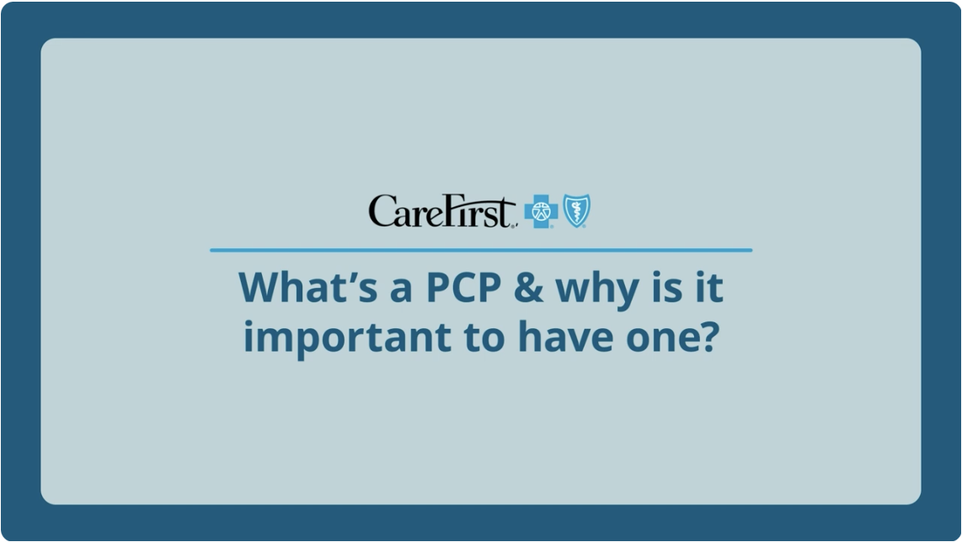
Why Choose a Primary Care Provider (PCP)?
The best way to receive consistent, quality care is by establishing a relationship with a primary care provider
Your PCP should:
Be your first call when you feel sick or have a medical issue
Know your family history, medications you take, factors that could impact your health
Have access to all your medical records
Guide you to the best and most appropriate care
Develop a personalized care plan for any health issues
Your PCP is the leader of your care team, which could include doctors, nurses, therapists and other healthcare professionals all with the same goal—keeping you healthy.
7

Slide 8

Provider Search Tool
Search for doctors, hospitals, urgent care centers, other providers—nationwide
Search by name or specialty
Browse by category—such as primary care, behavioral health, dental, retail pharmacy
Review provider highlights, including specialties, locations, credentials, CareFirst health plans accepted
Quickly access CloseKnit—our virtual practice for primary care, urgent care and behavioral health
carefirst.com/doctor

Slide 9
Medical Plan Options
9

Slide 10
BLUECHOICE HMO OPEN ACCESS
MEDICAL PLANS
Plan highlights
Selection of PCP | Required (BlueChoice Network PCP)
Referrals | Not required
Network labs | Use of LabCorp required
In-network | BlueChoice Network—only available in MD, D.C. and Northern VA (no balance billing)
Out-of-network | No coverage
Out-of-area coverage | Emergency or urgent care only

Slide 11
BlueChoice HMO Open Access (Regional Plan)
 | In-network
Annual medical deductible (individual/family) | None
Annual medical & drug out-of-pocket maximum (individual/family) | $3,500 single $9,400 Family
Preventive care | No charge
Primary care provider (PCP) office visit | $10 copay
Specialist office visit | $20 copay
Labs (non-hospital)/(hospital) | No charge
X-ray (non-hospital)/(hospital) | No charge
Specialty imaging (non-hospital)/ (hospital) | No charge
Convenience care (retail health clinic) | $10 copay
Urgent care | $20 per visit
Emergency room | $100 per visit (waived if admitted)
Inpatient hospital services—facility | $100 per admission
CareFirst BlueCross BlueShield
Proprietary and Confidential

Slide 12
Away from Home Care
Members who live in another part of the country for at least 90 consecutive days may be eligible for “Away From Home Care
Contact Member Services to enroll and ask for the Away From Home Care Coordinator.
Once enrolled, you have access to routine and urgent care through an affiliated BCBS HMO.
Great program for out-of-state college students. Not all states participate, so check first.
Must enroll on an annual basis.
CareFirst BlueCross BlueShield
Proprietary and Confidential

Slide 13
BLUEPREFERRED PPO
MEDICAL PLANS
Plan highlights
Selection of PCP | Recommended
Referrals | Not required
Labs | No restrictions
In-network | CareFirst PPO Network (no balance billing)
Out-of-network | Non-participating providers (may be balance billed)
Out-of-area coverage | BlueCard PPO Network (no balance billing) or non-participating providers (may be balance billed)

Slide 14
BluePreferred PPO (National Plan)
 | In-network | Out-of-network
Annual medical deductible (individual/family) | $750/$1,500 | $1,500/$3,000
Annual medical & drug out-of-pocket maximum (individual/family) | $1,500/$3,000 (Medical) $5,100/$10,200 (RX) | $3,000/$6,000 All cost are subject to in-network out of pocket maximum
Preventive care | No charge | 25% of CareFirst member cost
Primary care provider (PCP) office visit | $15 per visit | 25% of CareFirst member cost
Specialist office visit | $15 per visit | 25% of CareFirst member cost
Labs (non-hospital)/(hospital) | After deductible is met, 15% of CareFirst member cost | 25% of CareFirst member cost
X-ray (non-hospital)/(hospital) | After deductible is met, 15% of CareFirst member cost | 25% of CareFirst member cost
Specialty imaging (non-hospital)/ (hospital) | After deductible is met, 15% of CareFirst member cost | 25% of CareFirst member cost
Convenience care (retail health clinic) | $15 per visit | 25% of CareFirst member cost
Urgent care | $25 per visit | 25% of CareFirst member cost
Emergency room | $100 per visit (waived if admitted) | 25% of CareFirst member cost
Inpatient hospital services—facility | After deductible is met, 15% of CareFirst member cost | 25% of CareFirst member cost
CareFirst BlueCross BlueShield
Proprietary and Confidential

Slide 15
BlueChoice Advantage HSA
Members can live or work inside or outside of the CareFirst service area (Maryland, Washington D.C. and Northern Virginia) as this product provides national coverage.
 | In-network benefits¹ Lowest out-of-pocket costs | Out-of-network benefits Highest out-of-pocket costs
Network Search: “Find a Doctor” | BlueChoice Advantage | Your plan offers coverage for out-of-network providers² Balance billing may apply for non-participating providers
PCP Selection | Recommended, but not required | Recommended, but not required
Referrals | Not required | Not required
¹ Maximize your in-network benefits by searching for providers or facilities that are the lowest cost to you. Use the Out-of-Pocket Costs filter and select In Network: Lowest Out-Of-Pocket.
² Your plan offers coverage for out-of-network providers, but you will pay more out of pocket than you would if you selected an in-network provider or facility. .

Slide 16
BlueChoice Advantage HSA Benefit Chart
 | In-network | Out-of-network
Annual medical deductible (individual/family) | $1,650 Individual/$3,300 Family | $3,300 Individual/$6,600 Family
Annual medical out-of-pocket maximum (individual/family) | $4,000 Individual/$8,000 Family | $8,000 Individual/$16,000 Family
Preventive care | No Charge | 30% of Allowed Benefit
Primary Care Provider (PCP) office visit | Deductible, then $30 per visit | 30% of Allowed Benefit
Specialist office visit | Deductible, then $30 per visit | 30% of Allowed Benefit
Labs | Deductible, then $30 per visit | 30% of Allowed Benefit
X-ray | Deductible, then $30 per visit | 30% of Allowed Benefit
Specialty imaging | Deductible, then $30 per visit | 30% of Allowed Benefit
Convenience care (retail health clinic) | Deductible, then $30 per visit | 30% of Allowed Benefit
Urgent care | Deductible, then $75 per visit | Deductible, then $75 per visit
Emergency room | Deductible, then $300 per visit, (waived if admitted) | Deductible, then $300 per visit, (waived if admitted)
Inpatient hospital services—facility | Deductible, then $300 per admission | Deductible, then 30% of allowed benefit

Slide 17
Prescription Benefits
17

Slide 18


Importance of Prescription Benefits
Taking medications as prescribed by your doctor is important to keeping you healthy.
The prescription benefits offered to you by your employer provide an affordable and convenient way to make optimal decisions regarding your medications.

Slide 19


Using Your Prescription Benefits
Review your plan and call CareFirst Pharmacy Services at
800-241-3371 with any questions.
Save money with generics, when available.
Check your savings opportunities using the Rx Savings Advisor tool.
Use the Drug Pricing Tool to find lower cost drugs and check drug guidelines.
Fill prescriptions at one of 66,000 participating pharmacies nationwide or have them delivered right to your home using our Mail Order Pharmacy.

Slide 20
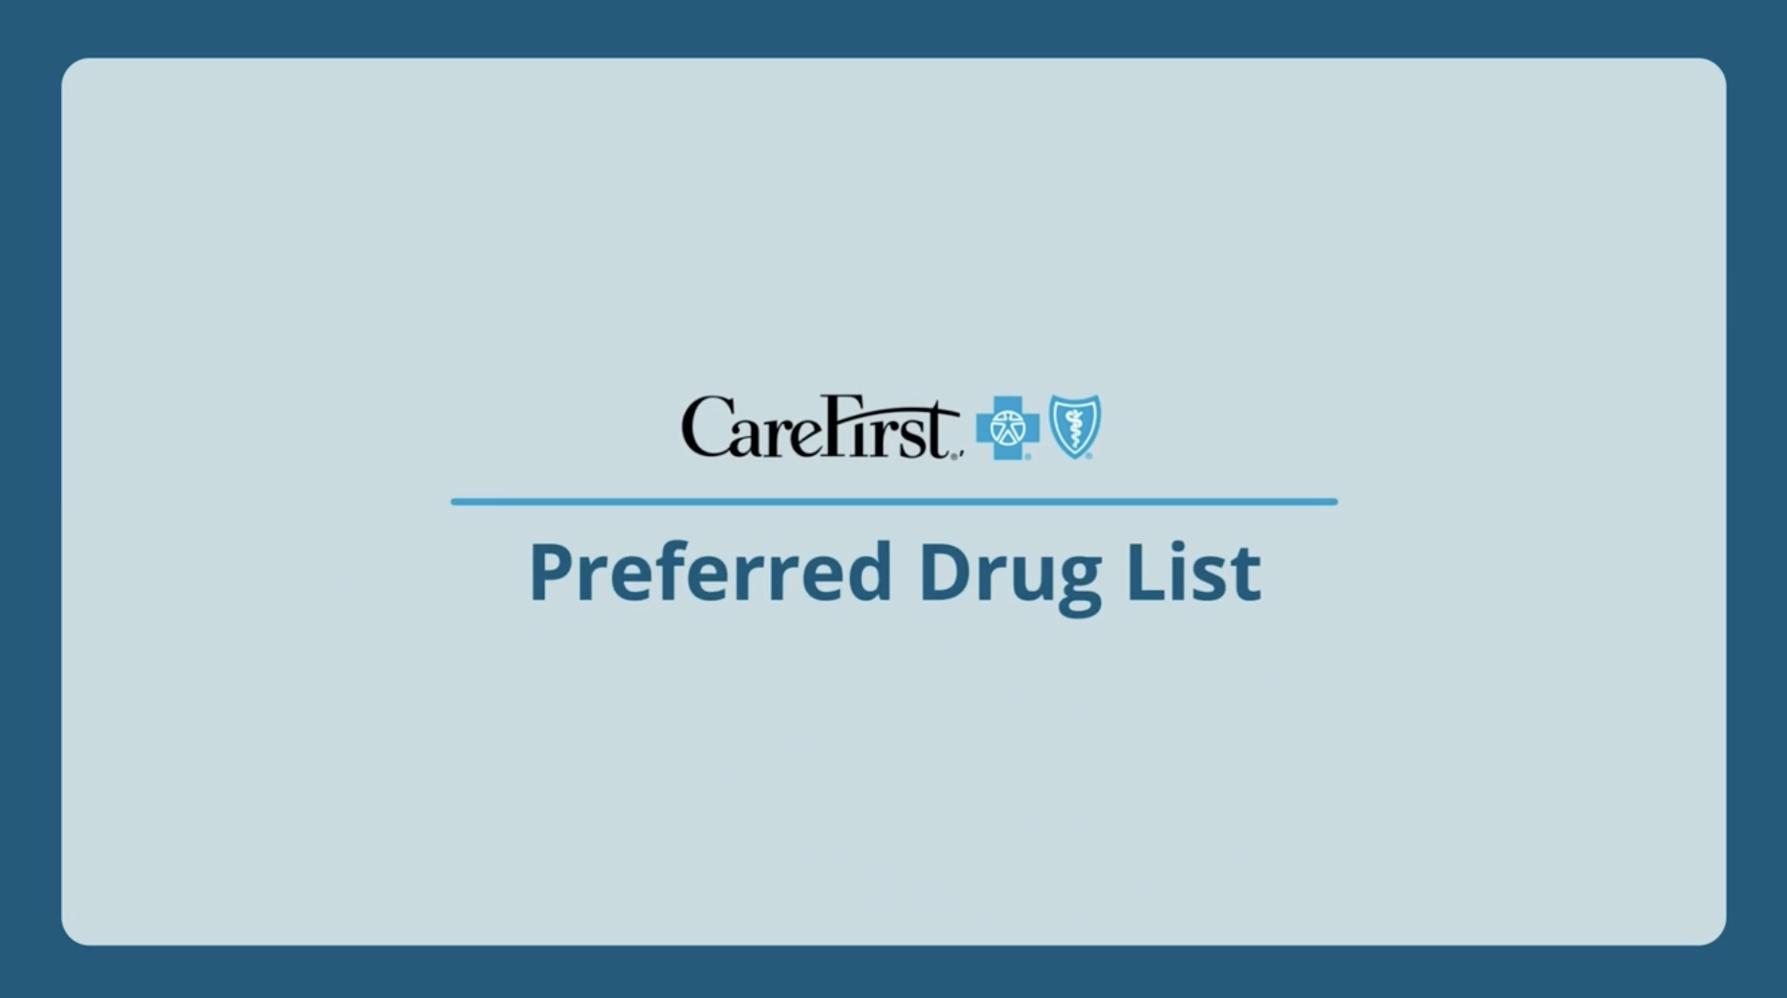
Understanding Your Formulary
Your formulary: Formulary 3
Available at carefirst.com/rx
List of prescription drugs your insurance plan covers
Organized by drug tiers so you can understand how much you pay for each drug
Your Preferred Drug List is a subset of your formulary that summarizes the generic and preferred brand medications covered by your plan that cost the least out-of-pocket
Your formulary is reviewed and updated on a quarterly basis to encourage utilization of safe and clinically cost-effective drugs
You will be notified by letter 30 days in advance if medications you’re currently prescribed will no longer be covered so you and your doctor can work together to find an alternative

Slide 21
Prescription Drug Types
Drug Type | Description
Preventive Drugs | Preventive drugs (e.g., statins, aspirin, folic acid, fluoride, iron supplements, smoking cessation products and FDA-approved contraceptives for women) are available at a zero-dollar cost share if prescribed under certain medical criteria by your doctor.
Generic Drugs | Generic drugs are the same as brand-name drugs in dosage form, safety, strength, route of administration, quality, performance characteristics and intended use. Generic drugs generally cost less than brand-name drugs.
Preferred Brand Drugs | Preferred brand drugs are brand-name drugs that may not be available in generic form but are chosen for their cost effectiveness compared to alternatives. Your cost share will be more than generics but less than non-preferred brand drugs. If a generic drug becomes available, the preferred brand drug may be moved to the non-preferred brand category.
Non-Preferred Brand Drugs | Non-preferred brand drugs often have a generic or preferred brand drug option where your cost share will be lower.
Specialty Drugs | Specialty drugs are medications that may be used to treat complex and/or rare health conditions and must be obtained from a pharmacy in the Exclusive Specialty Pharmacy Network or through mail order.
Maintenance Medications | Used to treat chronic, long-term conditions, such as high blood pressure or diabetes, and are taken on a regular, recurring basis. Available in 90-day supply.

Slide 22
5-TIER PHARMACY BENEFIT-
PRESCRIPTION BENEFITS
 | BlueChoice HMO Open Access Rx | BluePreferred PPO RX | BlueChoice Advantage CDHP HSA
Out of pocket Max* | $3,500 Individual $9,400 Family | $5,100 Individual $10,200 Family | $4,650 Individual $9,850 Family
Tier 1: Generic drugs | $20 | $20 | $20
Tier 2: Preferred brand drugs | $40 | $40 | $40
Tier 3: Non-preferred brand drugs | $55 | $55 | $55
Tier 4: Preferred specialty drugs | $40 | $40 | $40
Tier 5: Non-preferred specialty drugs | $55 | $55 | $55
* No cost drugs are preventive drugs/oral chemotherapy drugs/diabetic supplies.
Notes:
Maintenance Medications co-pays the same as retail

Slide 23
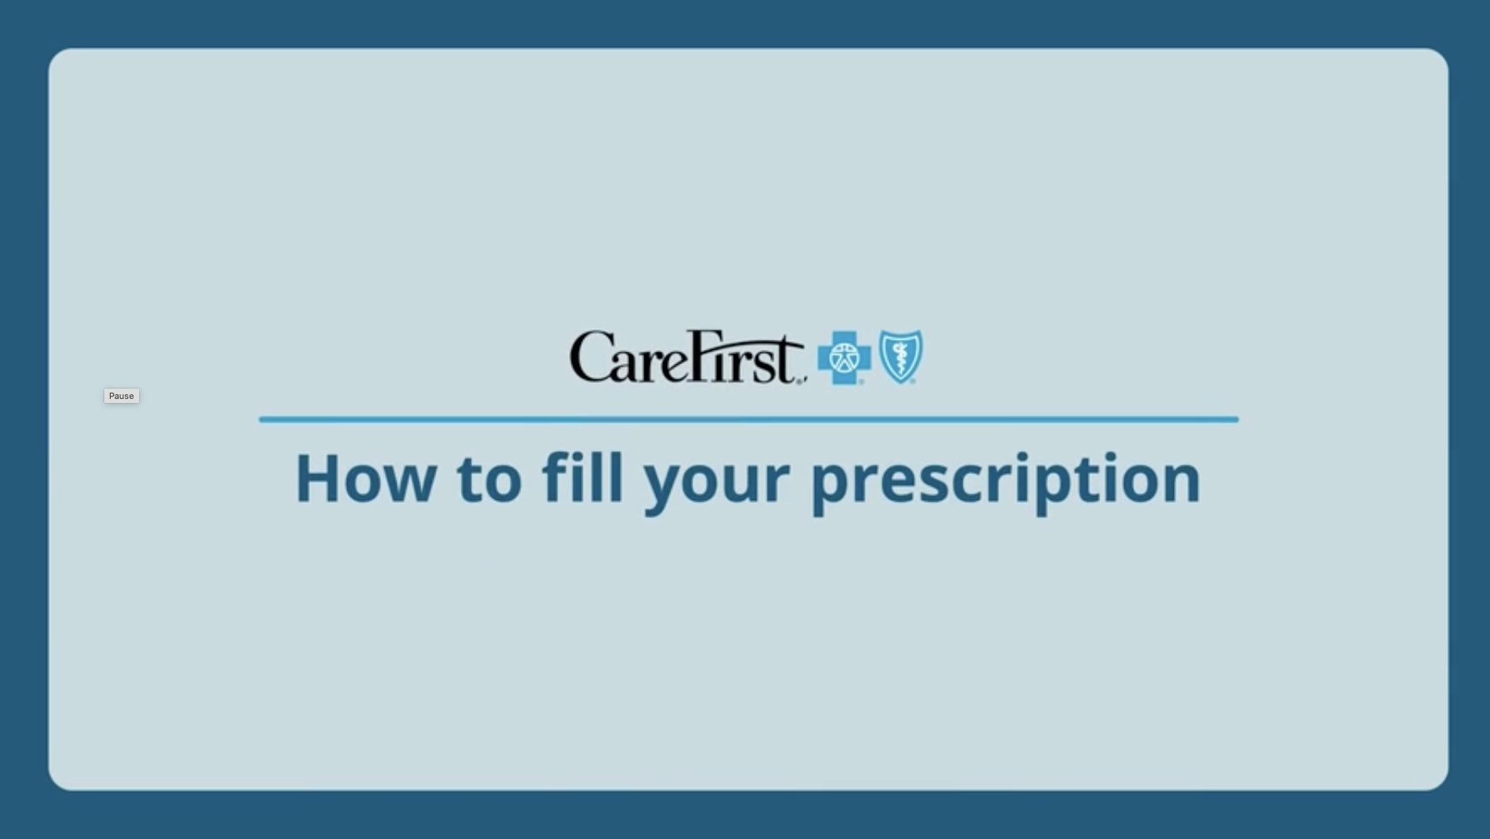

Mail Order Pharmacy
Save time and money on maintenance prescriptions
Fill prescriptions online, by phone or by mail
Schedule automatic refills
Select delivery location
Consult a pharmacist by phone 24/7
Receive email notification of order status
Visit carefirst.com/myaccount and log in.
Under the Coverage tab, select Drug and Pharmacy Resources.
Select Request a New Mail Order Prescription and enter the prescription information to be verified by your doctor.

Slide 24
Making the Most
of Your Plan

Slide 25
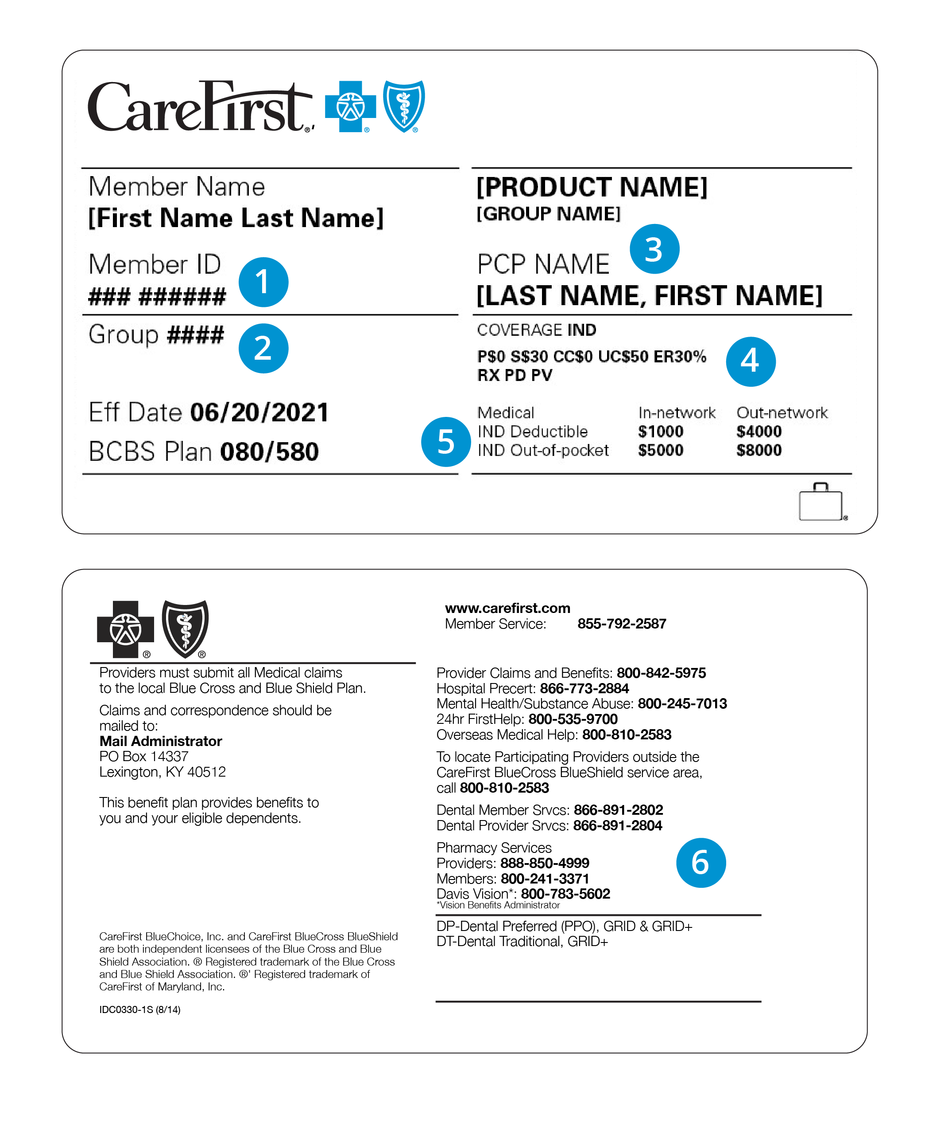
Your Member ID Card
1
Member ID
2
Group number
3
Primary care provider (PCP)
4
Copays
5
Deductible and out-of-pocket max
6
Important phone numbers
CareFirst BlueCross BlueShield provides administrative claims payment services only and does not assume any financial risk or obligation with respect to claims.
25

Slide 26
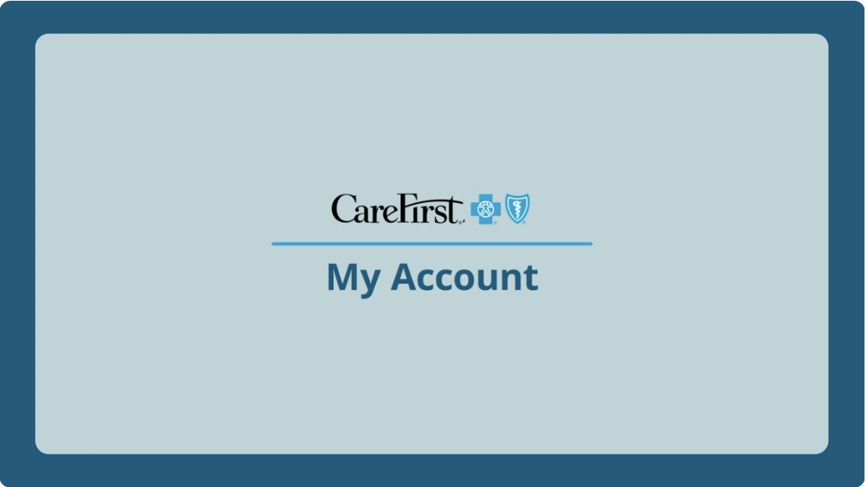
My Account
Your personalized member portal
Search for doctors, hospitals, urgent care centers, other providers nationwide
View, order or email member ID cards
Check claims and deductible status
Update communication preferences and password
Quickly access a variety of CareFirst member programs
Download the CareFirst app or add carefirst.com/myaccount to your mobile favorites!

Slide 27
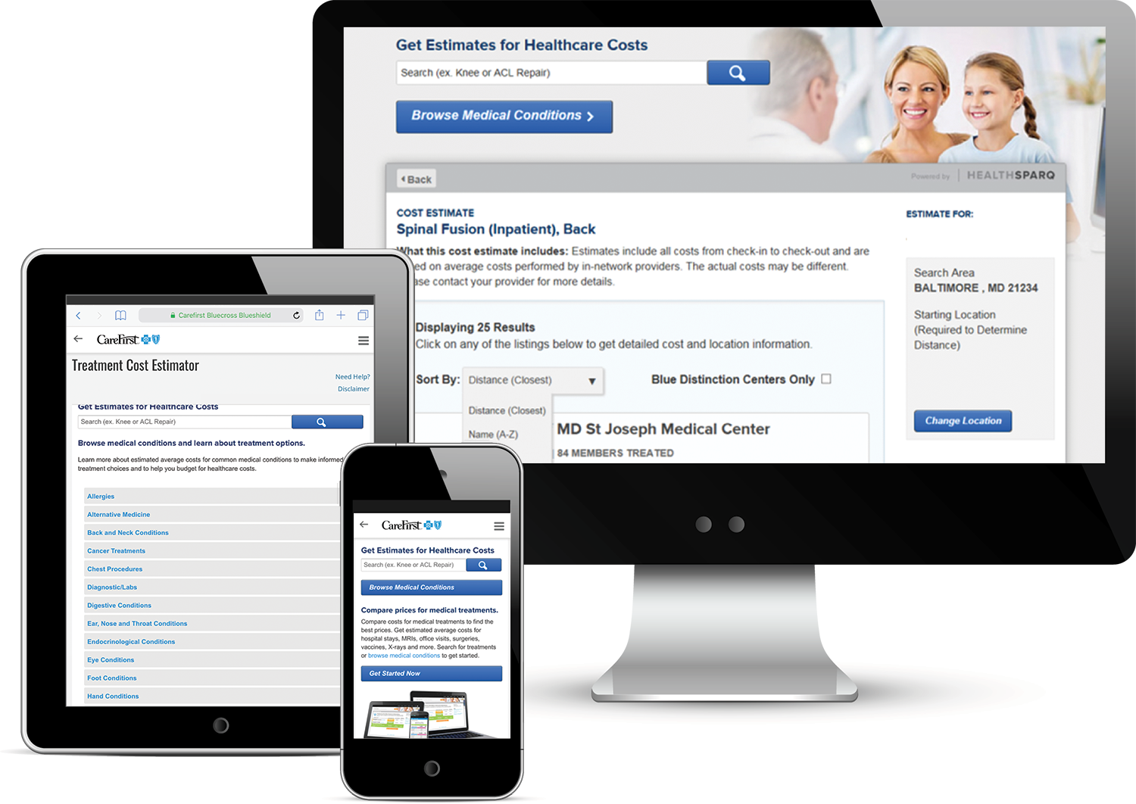
COST AND COMPARISON TOOLS
MAKE THE MOST OF YOUR PLAN
Treatment Cost Estimator
Provider comparison tools
(Find a Doctor)
Notes:
The treatment cost estimator allows you to enter a procedure, such as a hip replacement, and it will pull up facilities in your area and estimate the costs and highlight the most cost-effective facility. This can be done for many services.
You can compare and research doctors and hospitals by visiting the Provider Comparison Tools page of My Account. Here you will find resources to help you decide which doctor or facility is best for you.

Slide 28
Know Before You Go
Know where to go before you need care to save more on healthcare costs
Your Care Options | Cost | Needs or Symptoms | Available 24/7 | Rx | Virtual Care | In-Person Care
CloseKnit Virtual Care CloseKnit offers 24/7/365 virtual-first primary care, urgent care, mental health and other specialty services *in-person care available when applicable | $ | Preventive visits Urgent care Mental health therapy Psychiatry for ages 2+ | ✔︎ | ✔︎ | ✔︎ | ✔︎
24-Hour Nurse Advice Line Call 800-535-9700 for general questions about health issues or where to go for care | $0 | Cough, cold and flu Rashes | ✔︎ | ✘ | ✔︎ | ✘
PCP Visit Discuss diagnosis treatment of illness, chronic conditions, routine check-ups | $ | Routine physical Diabetic care | ✘ | ✔︎ | Verify availability with your provider. | ✔︎
Convenience Care (e.g., Retail clinics such as CVS MinuteClinic) Health screenings, vaccinations, minor illness or injury | $$ | Cough and cold Pink eye | ✘ | ✔︎ | ✘ | ✔︎
Urgent Care (e.g., ExpressCare or Patient First) Non-life-threatening illness or injury requiring immediate care | $$$ | Sprains Cut requiring stitches | ✘ | ✔︎ | ✘ | ✔︎
Emergency Room Life-threatening illness or injury | $$$$ | Chest pain Difficulty breathing | ✔︎ | ✔︎ | ✘ | ✔︎
Lactation consultation
Nutrition and diet support
Billing and benefits support
Medication questions
Cough, cold, flu, allergies
Bronchitis
Ear pain
Flu shot
Minor burns
Sore throat
Uncontrolled bleeding
Major burns
* Members with an HSA-qualified plan will pay $0 after meeting the deductible.
28

Slide 29






Virtual Care
CloseKnit, CareFirst’s leading virtual-care practice, gives you 24/7 access to primary care, urgent care, therapy and more through your computer or the CloseKnit mobile app
Advanced primary care
Dedicated Care Team to provide preventive care and support for chronic conditions. For adults ages 18+.
New parent support
Lactation services and support for parents, including prenatal risk assessments, post-natal feeding education and weaning programs.
Urgent care
Same-day care to treat minor injuries and common illnesses fast. Average wait time is 30 minutes or less. For adults and children ages 2+.
Nutrition services
Counseling and nutrition plans to support health needs, lifestyle goals, chronic illnesses and weight loss. For adults and children ages 5+.
Mental health services
Expert help from licensed therapists and psychiatrists, including short- and long-term therapy, as well as medication management and support. For adults and children ages 2+.
Scan the QR code or visit closeknithealth.com to get started.
29

Slide 30
Behavioral Health
30

Slide 31


Importance of Behavioral Health
1 in 5 American adults experiences some form of mental illness in any given year.¹
As a CareFirst member, you have access to providers and resources if you or a loved one are living with a behavioral health or substance use disorder.
¹ NAMI (National Alliance on Mental Illness). Mental Health by the Numbers. https://www.nami.org/mhstats.

Slide 32



Behavioral Health Support
CareFirst offers specialized services and programs when you need assistance related to depression, drug or alcohol dependence, stress, eating disorders or other behavioral health issues.
If you choose to participate in these services, all interactions between you and your provider(s)
are confidential.
800-245-7013
carefirst.com/mentalhealth

Slide 33


Personalized Support
You’ll receive one-on-one support from specialty-trained and licensed behavioral health care coordinators who can:
Set up appointments with behavioral health providers
Explain your treatment options
Collaborate with your PCP
Create an action plan
Find support groups and other resources
33

Slide 34
Virtual Care
CloseKnit, CareFirst’s leading virtual-care practice, gives you 24/7 access to primary care, urgent care, therapy and more through your computer or the CloseKnit mobile app
Advanced primary care
Dedicated Care Team to provide preventive care and support for chronic conditions. For adults ages 18+.
New parent support
Lactation services and support for parents, including prenatal risk assessments, post-natal feeding education and weaning programs.
Urgent care
Same-day care to treat minor injuries and common illnesses fast. Average wait time is 30 minutes or less. For adults and children ages 2+.
Nutrition services
Counseling and nutrition plans to support health needs, lifestyle goals, chronic illnesses and weight loss. For adults and children ages 5+.
Mental health services
Expert help from licensed therapists and psychiatrists, including short- and long-term therapy, as well as medication management and support. For adults and children ages 2+.
Scan the QR code or visit closeknithealth.com to get started.
34

Slide 35
CareFirst WellBeing℠
35

Slide 36

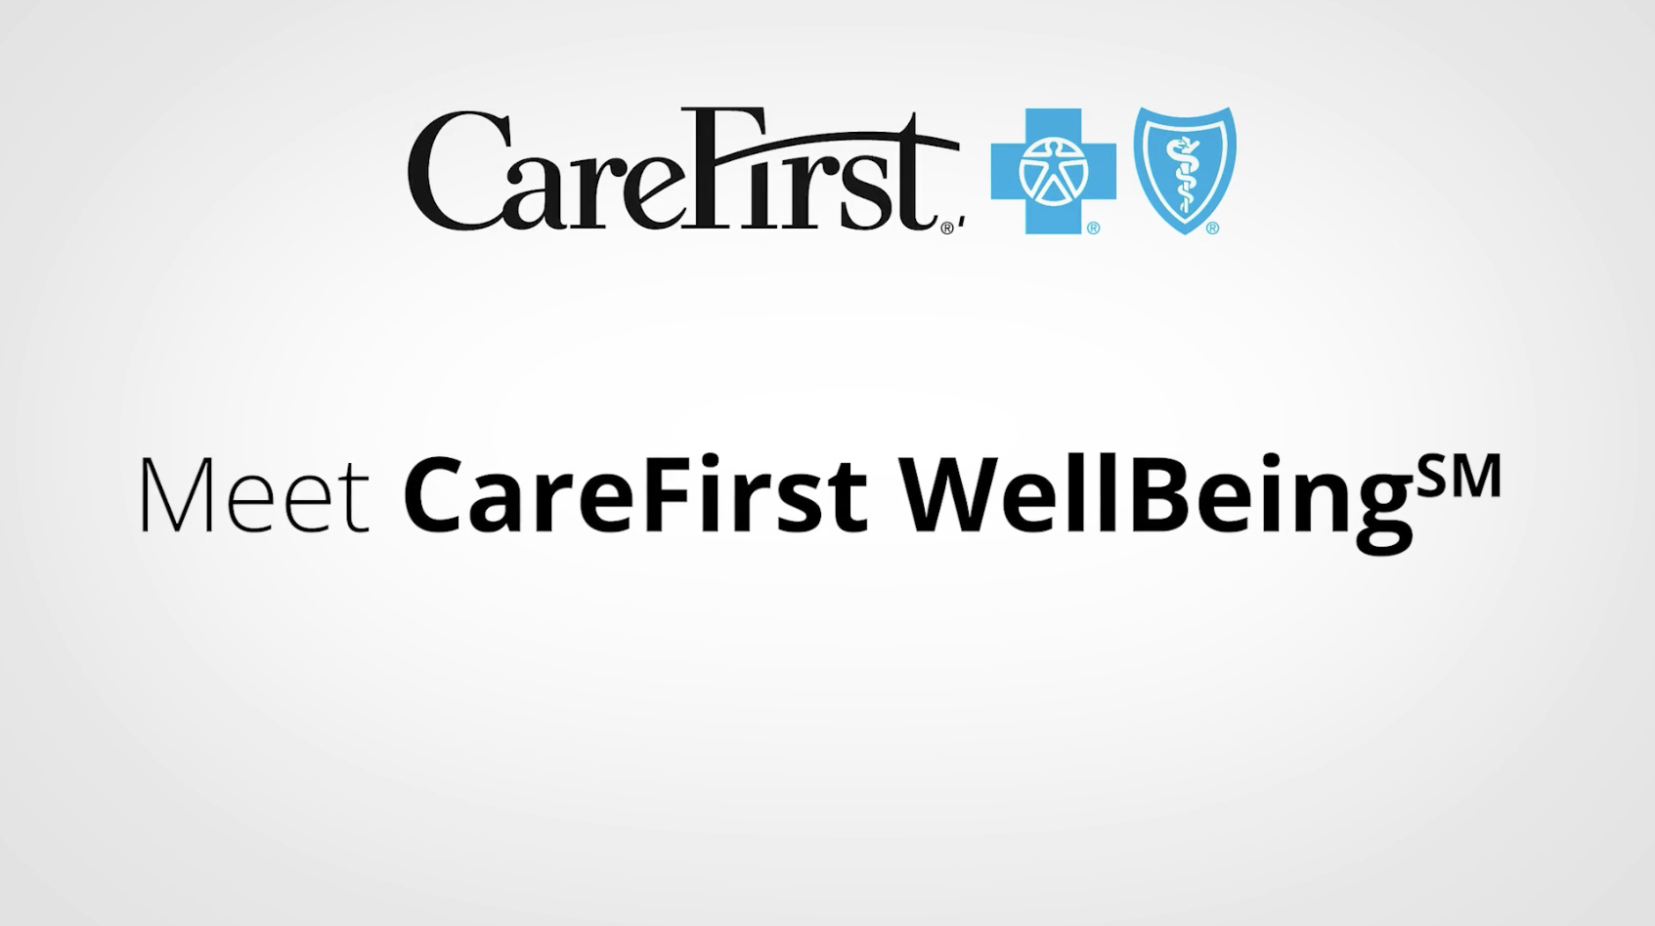

Introducing CareFirst WellBeing*
Begin exploring your personalized digital connection to a healthier life by visiting carefirst.com/wellbeing.
* This well-being program is administered by Sharecare, Inc., an independent company that provides health improvement management services to CareFirst members. Sharecare, Inc. does not provide CareFirst BlueCross BlueShield products or services and is solely responsible for the health improvement management services it provides.

Slide 37
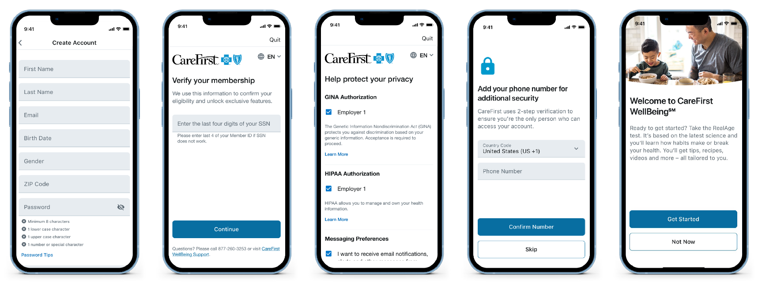
CREATING A CAREFIRST WELLBEING ACCOUNT
Create Account
Verify Membership
Authorizations
Add Phone
RealAge
Need Help? Contact CareFirst WellBeing Customer Support at 877-260-3253
Notes:
Next, new users will create their accounts by filling in the required fields shown here and choosing your login credentials.
We will verify your CareFirst enrollment by the last four digits of your social security number. This is important as it ensure that you are setting up your account with the CareFirst enterprise version of the app and not the consumer version which has limited functionality.
Next you will acknowledge the GINA and HIPAA authorizations and set up your messaging preferences.
Just a quick note on privacy here. All the information you input into your CareFirst wellbeing profile is a benefit to you. Intended to really help you gain a better awareness of your current health status and to make improvements where needed. And your personal health information will never be shared with anyone, including your employer. Employers only receive very high-level aggregate participation reports. But never any individual health information.
Next you will add your phone number and as an additional layer of account security, CareFirst wellbeing features a 2-step verification. So, the first time you sign in, it will require a 6-digit verification code and you can this code via email, text message or an automated phone call.
Finally, you will click get started to start exploring the app or to launch the real age health assessment.

Slide 38






Connections to WellBeing
Motivating digital resources anytime, anywhere
RealAge®
Learn the physical age of your body, compared to your calendar age with the online health assessment.
Challenges
Get extra motivation for achieving your health goals.
Personalized health timeline
Receive recommendations and health information tailored to your goals and interests.
Health profile
Access your important health data all in one place.
Trackers
Connect your wearable devices or enter your own data to monitor sleep, steps, nutrition
and more.
Meditation, relaxation and more
Break free from stress with mindfulness tools, unwind at the end of the day or ease into a restful night of sleep with meditation, streaming music and videos.

Slide 39
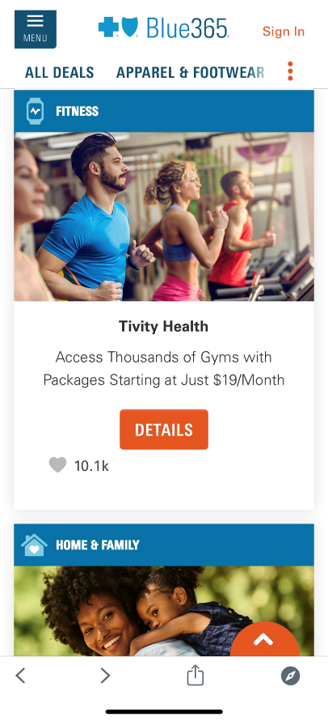
Blue365 Discount Program
Exclusive health and wellness discounts from top national and local retailers:
Apparel and footwear
Fitness (equipment, memberships)
Hearing and vision (hearing aids, Lasik, eye wear)
Home and family (baby, pets, home office, finance)
Nutrition
Personal care (oral care, grooming, skin care)
Travel (vacation, hotel, rental cars)
Access Blue365 through the CareFirst WellBeing app or by visiting carefirst.com/wellnessdiscounts.

Slide 40
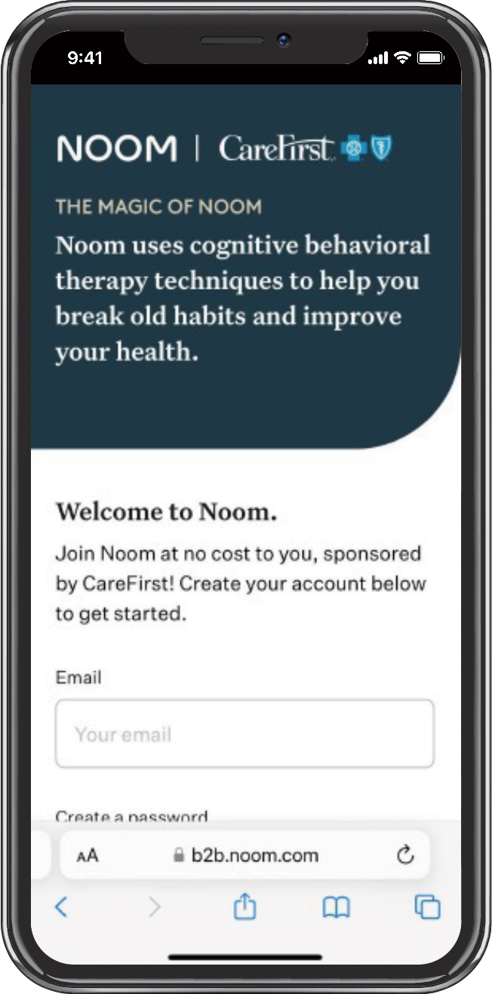
Noom
A digital, evidence-based weight and diabetes prevention program that helps you achieve sustainable, healthy habits over time
Psychology-based approach to help you better understand your relationship with food
Techniques that teach you the “why” behind your habits and how to change them
Interactive, digestible content, just 5–10 minutes daily
Option of a personal coach to support you as you move at your own pace
Added features like Noom Move, an extensive collection of workouts, as well as
GLP-1 Companion—a personalized experience for members on a GLP-1 weight loss medication
Get started with Noom today by creating or logging in
to your CareFirst WellBeing account.
Noom is brought to you on behalf of your CareFirst WellBeing program. Noom is an independent company that provides health improvement management services to CareFirst members. Noom does not provide CareFirst BlueCross BlueShield products or services and is solely responsible for the health improvement management services it provides.

Slide 41




BLUE REWARDS INCENTIVE PROGRAM
WELLBEING
You can earn a reward for completing one, or all of the following activities:
Consent to receive wellness emails and take the RealAge® test
The RealAge test is a simple questionnaire that will help you determine the physical age of your body compared to your calendar age.
Must complete within 180 days of your effective date.
Select a primary care provider (PCP) and complete a health screening
You can visit your PCP or a CVS MinuteClinic® to complete your screening.
Must complete within 180 days of your effective date.
Retake the RealAge® test
If you earned the reward for taking the test initially, you can earn an additional reward for retaking it after 90 days.
RealAge answers must be updated or confirmed no earlier than 90 days after the original assessment, and before the end of the benefit period.
Participate in health coaching
Session 1 = $30
Session 2 = $70
Session 3 = $100
Sessions must be held 2–60 days apart and must be completed before end of benefit period.
Earn $50
Earn $100
Earn $25
Earn up to $200
CVS MinuteClinic is an independent company that provides medical services to CareFirst members. CVS MinuteClinic does not provide CareFirst BlueCross BlueShield products or services and is solely responsible for the medical services it provides.

Slide 42
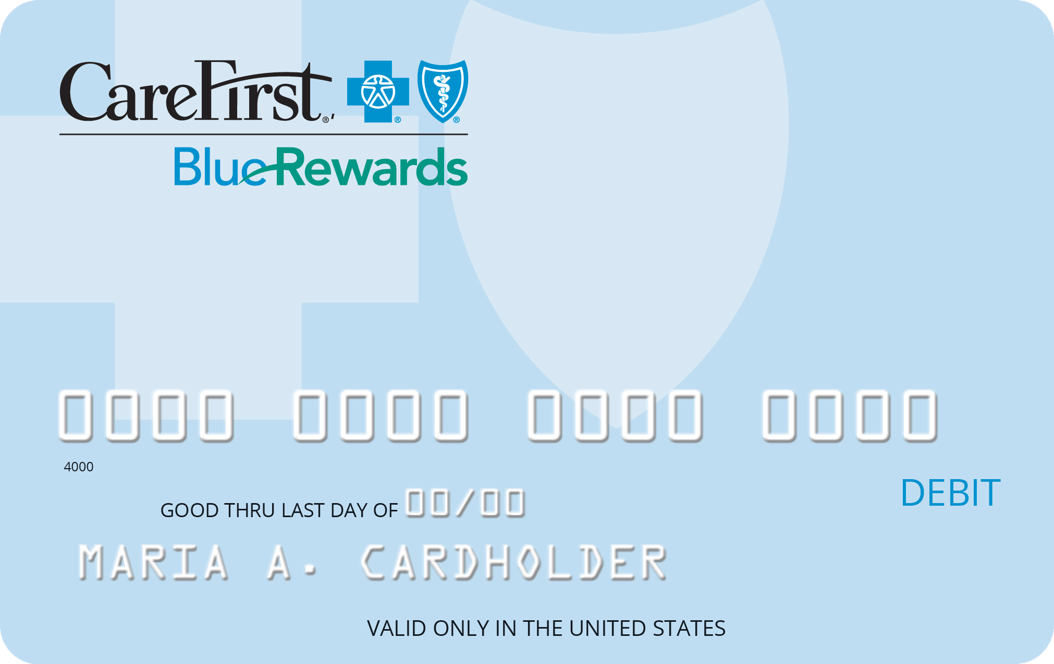
BLUE REWARDS INCENTIVE TYPE
WELLBEING
You’ll receive the CareFirst Blue Rewards Visa® Incentive Card in the mail once you complete any of the activities. The incentive card can be used to pay for your annual deductible or other out-of-pocket expenses like copays or coinsurance related to your CareFirst health plan.
You must use the funds before the end of the benefit period, as the balance does not carry over.
The CareFirst Blue Rewards Visa Incentive Card is issued by The Bancorp Bank, Member FDIC, pursuant to a license from Visa U.S.A. Inc. Cards may be used only at merchants in the U.S. and District of Columbia wherever Visa debit cards are accepted for eligible expenses. See Cardholder Agreement for details.

Slide 43
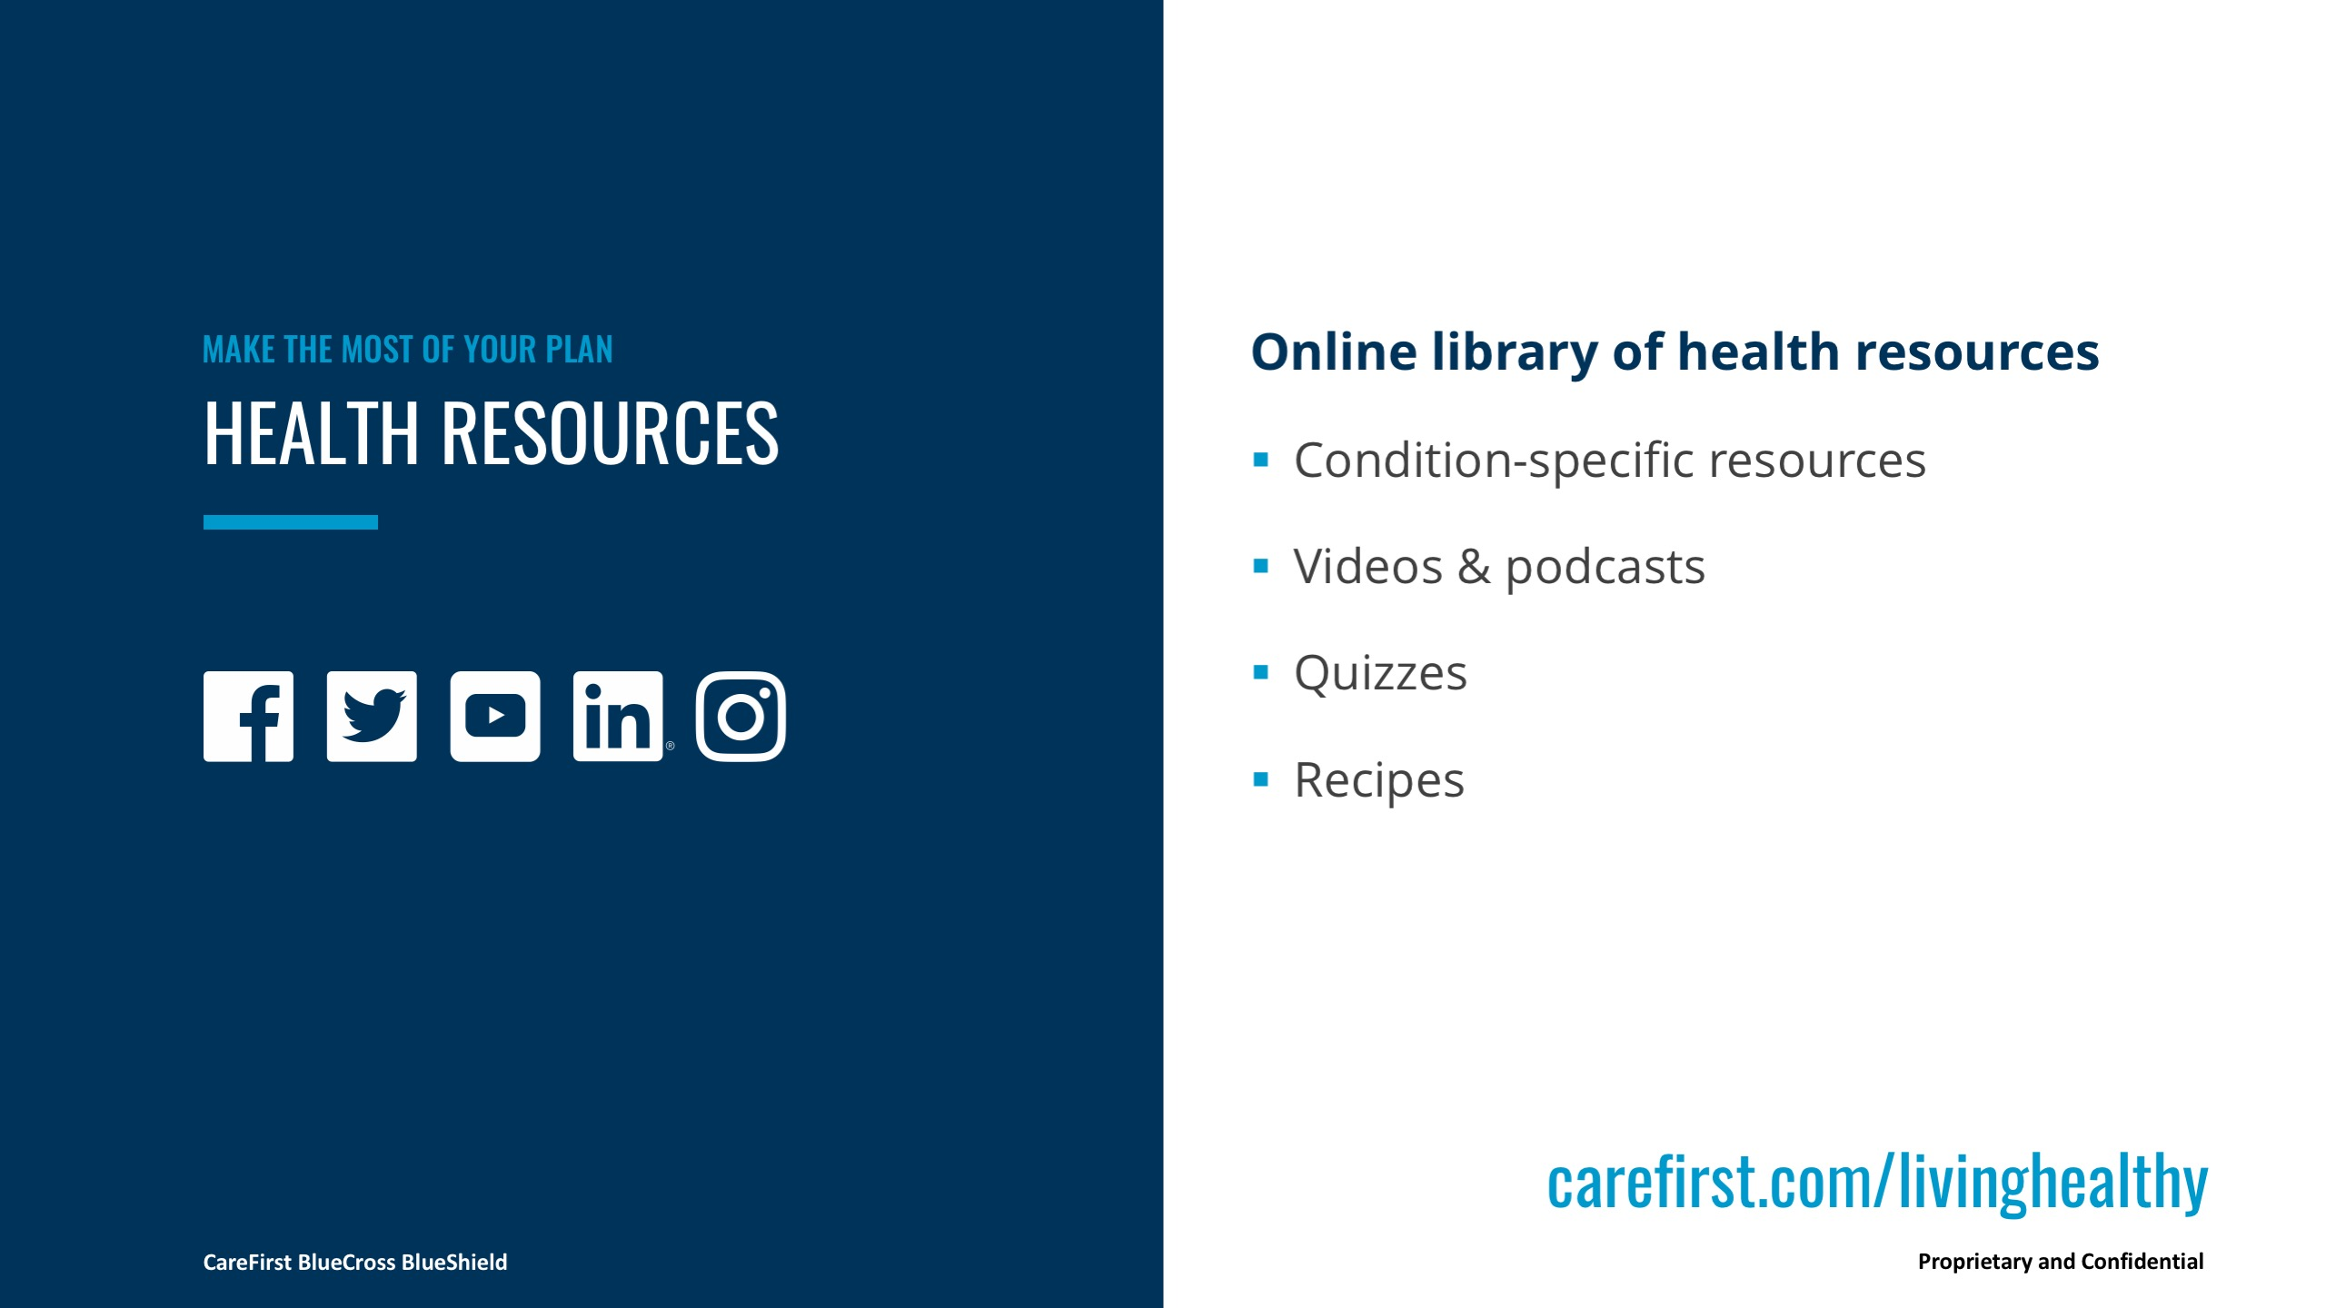
Notes:
Our Health Library can be accessed at CareFirst.com and you can get tips on exercise, stretches, recipes, and just general health and wellness info. We post links to other articles and useful, podcasts for general wellness and even specific conditions.
You can also reach us on Facebook and Twitter to get additional tips, info, recipes, and ask basic questions.

